Slide 1

Taking an urban approach to wellbeing research - how and why to involve communities
@JessicaPykett
Professor Jessica Pykett
October 2023

Slide 2
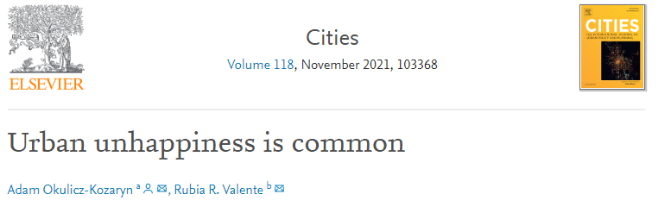
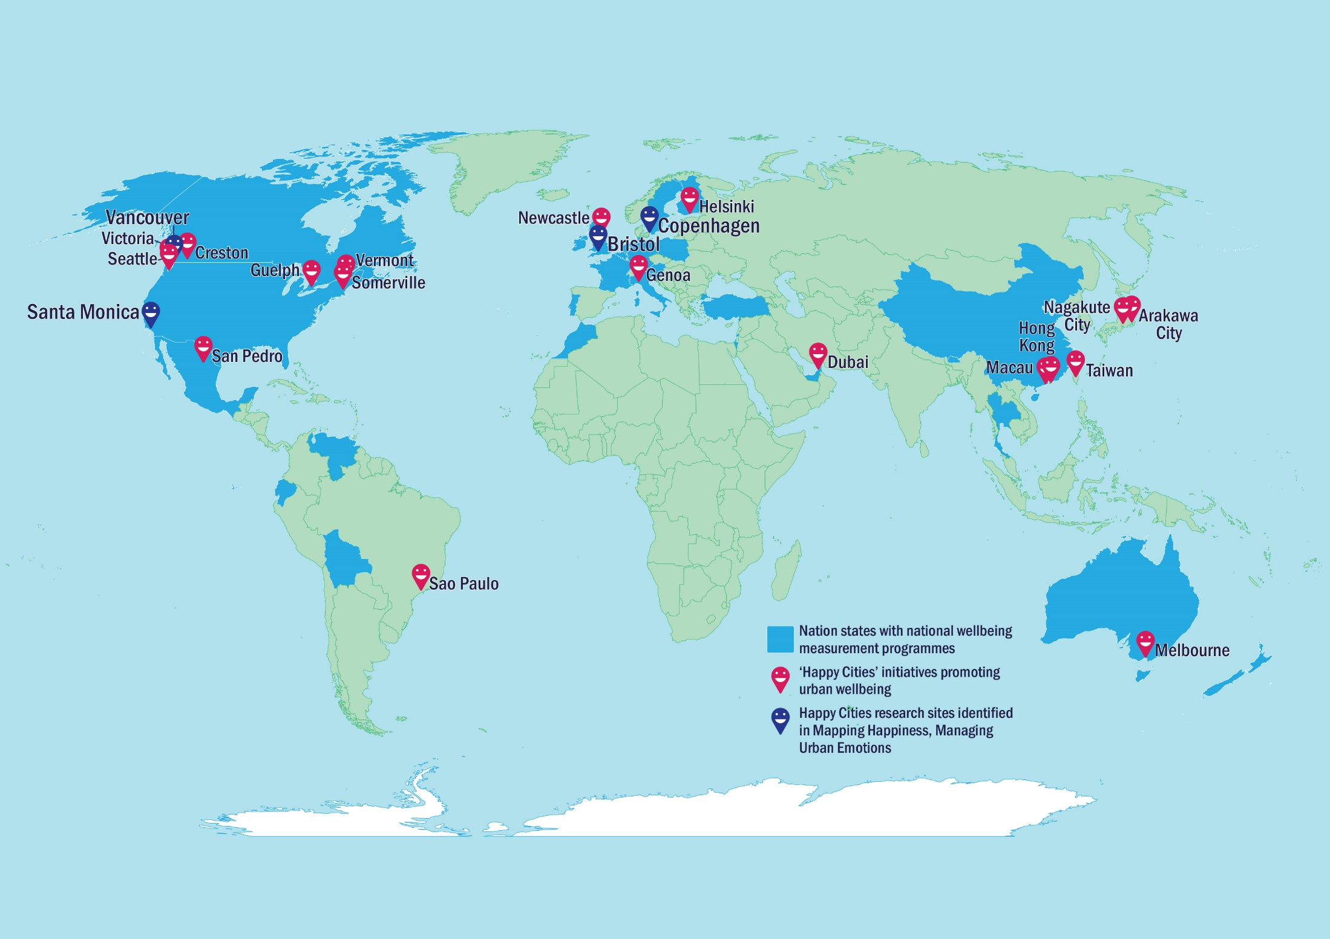
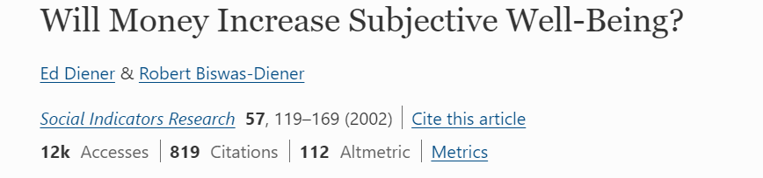
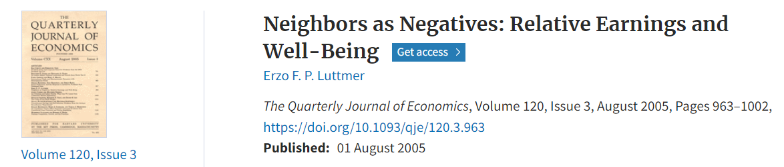
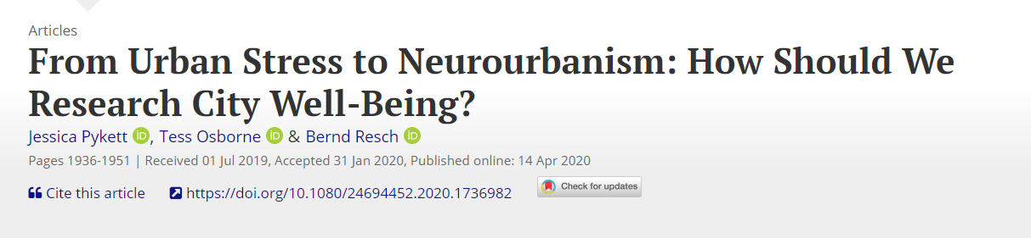
Why cities, why wellbeing, why now?
Mapping “Happy cities” initiatives
Notes:
There is a lot of research interest in the impacts of urban living on wellbeing and happiness, within urban studies, among economists, psychologists, psychiatrists, public health, neuroscience, geographers.
There is not a linear relationship between urban living, money and happiness.
People are not necessarily miserable, income is not straightforwardly or solely determining happiness - though we know that low income certainly does, and income inequalities too.
How well your neighbours are doing relevant to you is important.
Many city authorities, national governments, social enterprises, businesses, city branding and urban liveability projects, researchers of all colours and charities are focussing on urban spaces as drivers of wellbeing.
They are focused on how the city ‘gets under the skin’ , the ‘urban brain’ and psychological distress/stress.
In my research I have also focussed a lot on experimental methods for ‘affective capture’, collaborated with psychiatrists, neuroscience, behavioural medicine, health psychologists, happy cities organisations on addressing urban wellbeing inequalities
But I am concerned about how some of this research is now used as ‘expertise and evidence’ about urban wellbeing – for me how to research this remains an open question and ongoing dialogue. At the heart of which are communities and policies to address inequalities.
Some of this concern is about the use of the term ‘urban’ – this is the focus of my talk today
In the search for sustainable and just transitions for urban environments, the ‘urban’ comes to signify a range of different things – a built environment, a scale of enquiry, a source for solutions to intractable global problems, a place for social change, a driver of environmental behaviour, a determinant of health and wellbeing, a site for technological prediction and management, a political forum for governance, a sense of dislocation from nature.
What is at stake in approaching the urban as a form, a space, a culture or a polity, and how can these different ‘urbans’ shape community wellbeing?
Drawing on the research activities of the Centre for Urban Wellbeing at the University of Birmingham, UK, this talk will explore the links between how the urban is conceptualised, experienced and governed in order to demonstrate the value of community engaged research on sustainable and inclusive wellbeing.

Slide 3
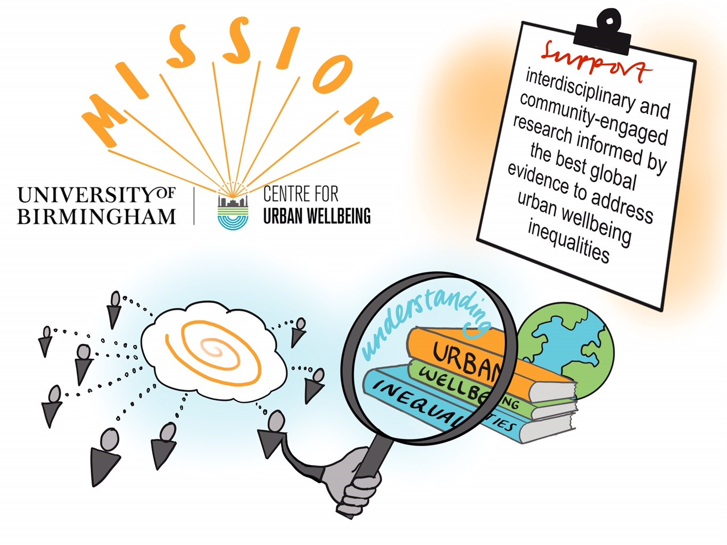
Illustrations by www.thinkbigpicture.co.uk @laurabrodrick
Notes:
First I want to say a bit about our research centre at University of Birmingham to give a picture of the range of interdisciplinary research that we do, and at the end invite you to get involved in some of our international opportunities.
Wellbeing has become a central goal for government policy, and research and evidence on the drivers of wellbeing plays a key role in informing policy strategy and decision-making. The 2022 Levelling up white paper includes a mission to improve wellbeing and reduce wellbeing inequalities across all areas of the UK. This is an important time to be gathering together urban wellbeing researchers, policymakers and change-makers to build capacity in investigating, assessing and activating place-based initiatives.

Slide 4
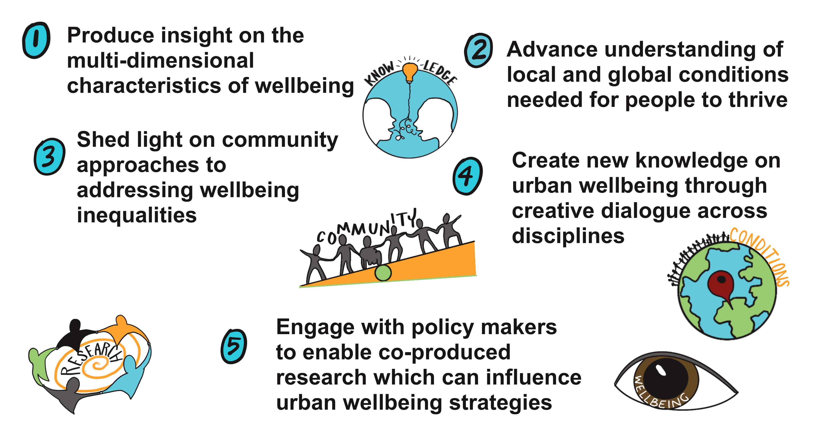
5 Goals of the Centre for Urban Wellbeing
Notes:
Act as a long-term steward of relationships between research and practice on the topic of urban wellbeing

Slide 5
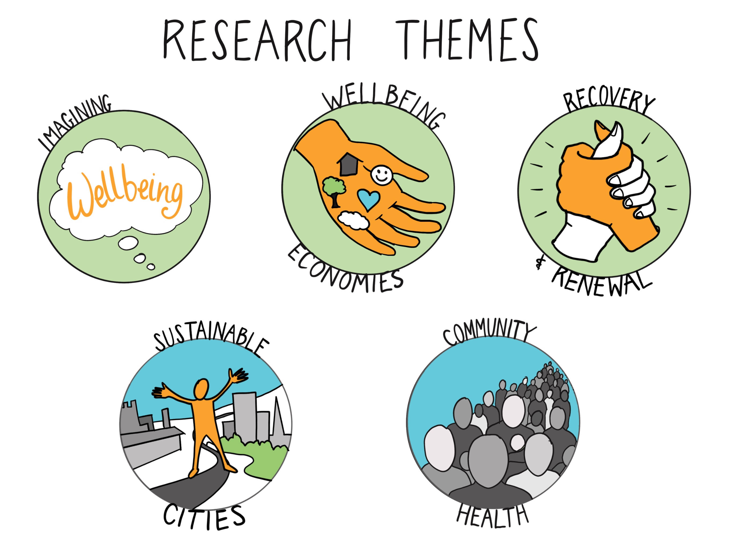
Notes:
Imagining Wellbeing- envisioning the experience of wellbeing and the systemic factors that either inhibit or facilitate it; how creative narratives can help us rethink wellbeing.
Wellbeing Economies - understanding and addressing subjective wellbeing inequalities in relation to absolute and relative income and demographic differences
Recovery and Renewal - ways in which wellbeing takes shape in diverse places and spaces and how the notion of community is mobilised in policy, practice and decision making
Community Health – research which brings together social, psychological, medical, lifestyle and environmental dimensions to understand disease prevalence, and the living conditions which enable people to thrive- health promotion, preventative action, protection and interventions
Sustainable Cities – focus on relationship between built form, urban design and the opportunities afforded those who live and work in cities, to promote resilience and sustainability in health, wellbeing, employment, education

Slide 6
Research Themes: areas of specialism
Imagining Wellbeing
Our goal is to bring together researchers from across the Humanities and Social Sciences, in order to envision the experience of wellbeing and the systemic factors that either inhibit or facilitate it. Our focus is on how historical, political, and creative narratives about human flourishing, attachment, welfare, or comfort can help us rethink the private and communal sustainability of wellbeing.
Wellbeing Economies
We are committed to understanding and addressing subjective wellbeing inequalities. Low absolute and relative income drive low subjective wellbeing. We must do more when it comes to sub-group differences in initiatives that aim to improve subjective wellbeing, including according to income and other factors like age, disability and ethnicity.
Recovery and Renewal
The effects of spatially-targeted regeneration and development are much debated. We examine the complex ways in which wellbeing takes shape in diverse places and spaces and how the notion of community is mobilised in policy and practice. How do wellbeing relationships between communities, local authorities and third sector organisations develop, and how are communities engaged, represented and involved in decision-making around wellbeing?
Sustainable Cities
Evidence continues to mount on the relationship between built form and the opportunities afforded those who live and work in cities, in health, wellbeing, employment, education. Our focus is on how urban communities experience the built form and how this interacts with the city’s sustainability, liveability and resilience priorities, and how this knowledge can shape urban design and regeneration practices.
Community Health
We bring together multiple social, psychological, medical, lifestyle and environmental dimensions to understand disease prevalence, and conversely, the living conditions which enable people to thrive. We focus on the conditions, activities, resources and capacities of specific social groups to secure good health and wellbeing. Our research explores activities including health promotion, preventative action, protection and interventions.

Slide 7
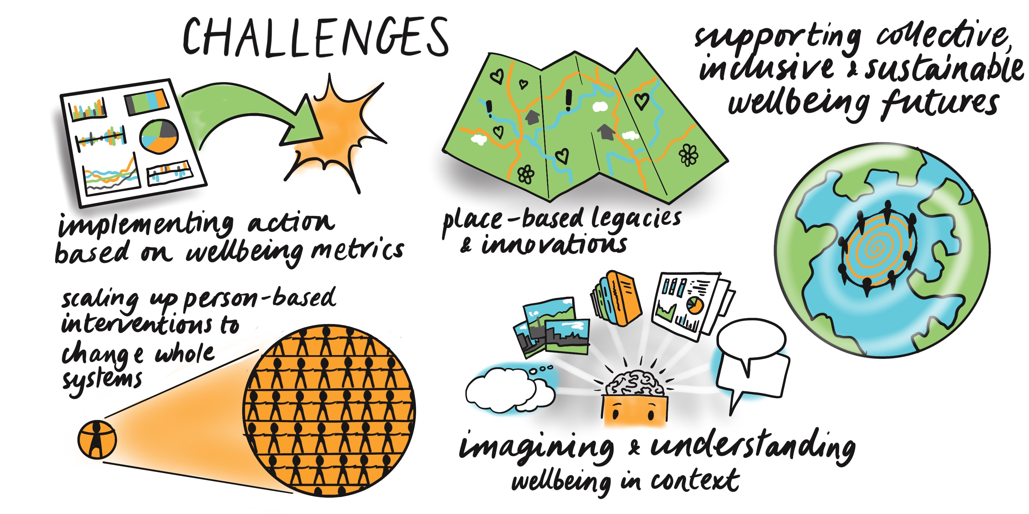
Context and challenges

Slide 8
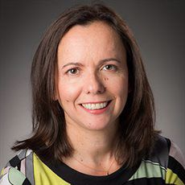
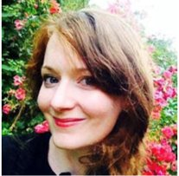
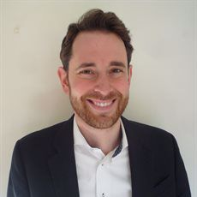
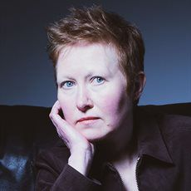
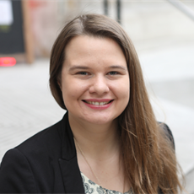
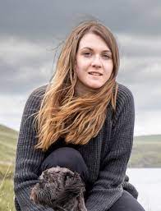


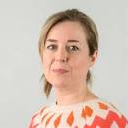
Research leads
Prof Afroditi Stathi
Life & Environmental Sciences
Dr Dorothy Butchard
Arts and Law
Dr Koen Bartels
Social Sciences
Dr Joanne Leach
Engineering and Physical Sciences
Dr Laura Kudrna
Medical and Dental Sciences
Preventing systematic health inequalities through community organisation
Imagining Wellbeing
Rethinking historical, political and creative narratives of wellbeing
Recovery and Renewal
Engaging communities in decision making around wellbeing
Sustainable, Liveable and Resilient Cities
Shaping urban form, infrastructures and built environment
Wellbeing Economies
Driving alternative measures of social progress
Community Health
Deputy: Dr Grace Wood, SportExR
Deputy: Dr Rebecca Wynter, IAHR & University of Amsterdam
Deputy: Dr Gerald Jordan, Psychology
Deputy: open
Deputy: Dr Rebecca Johnson, IAHR

Slide 9
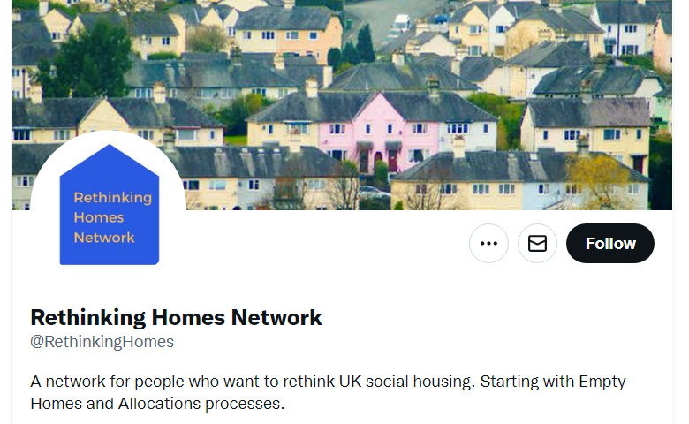
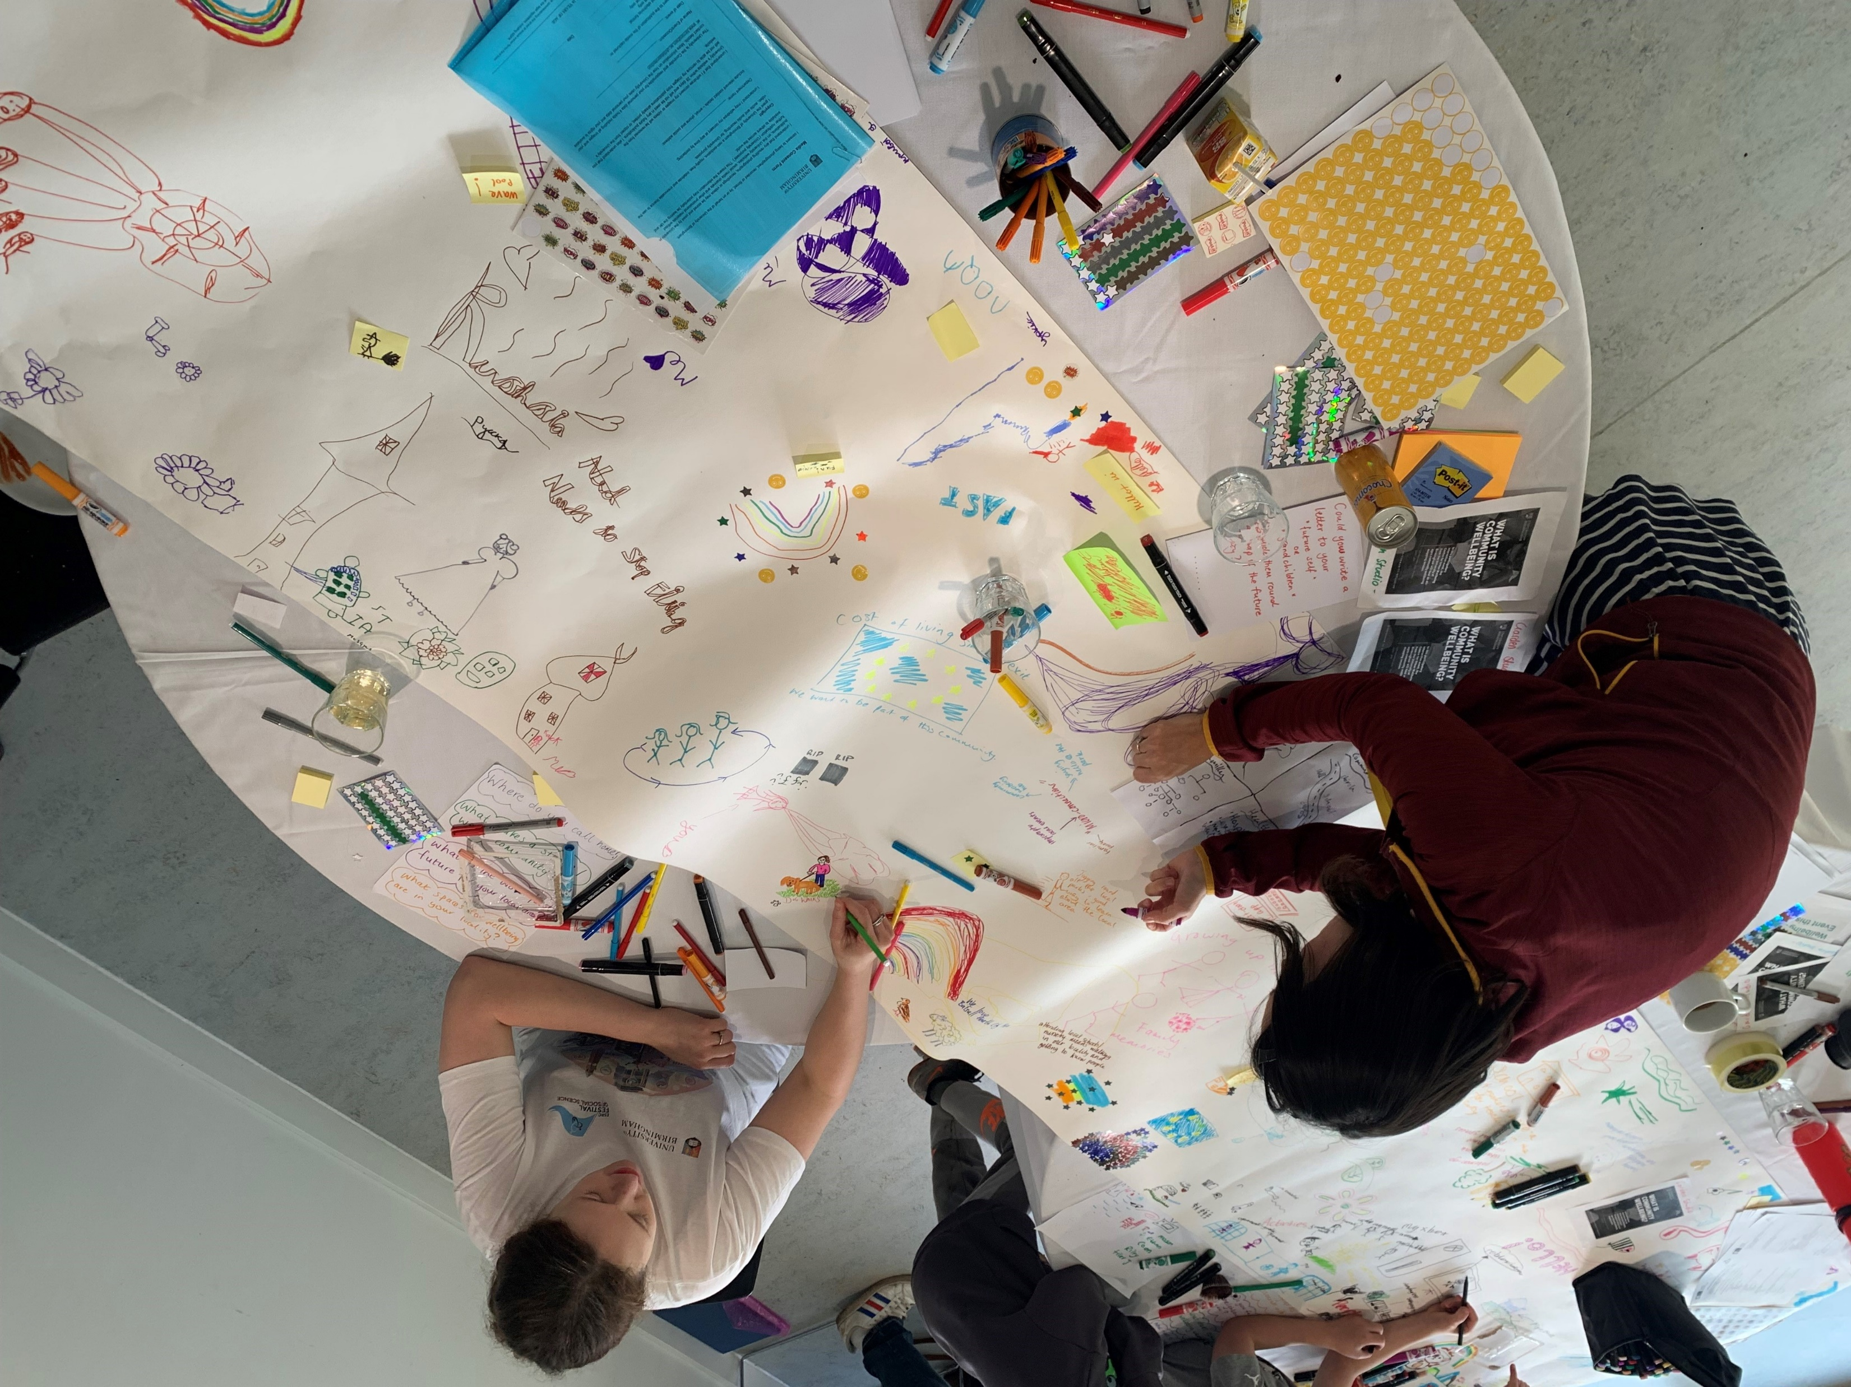
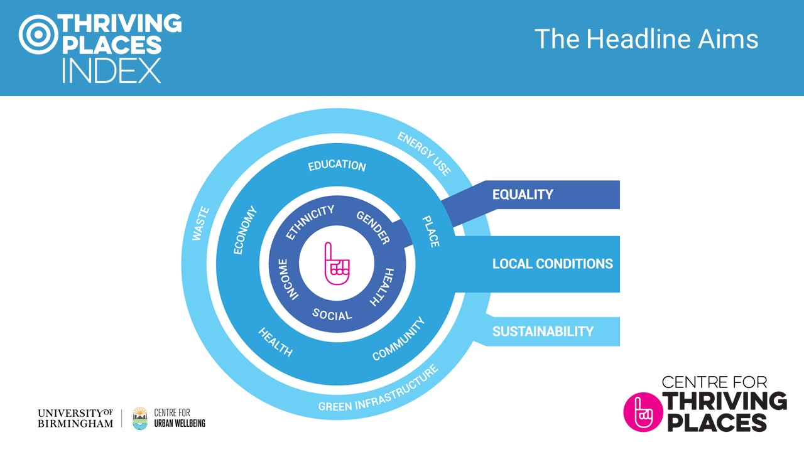
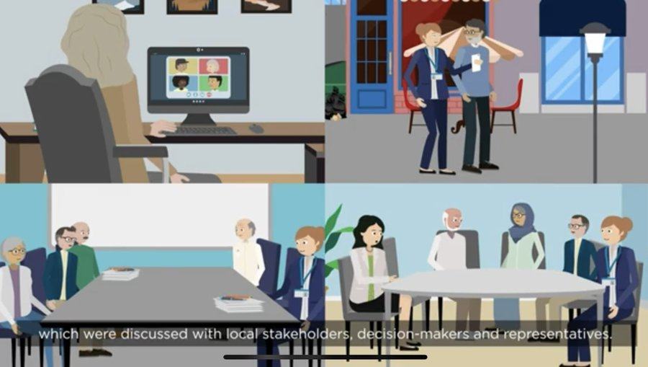
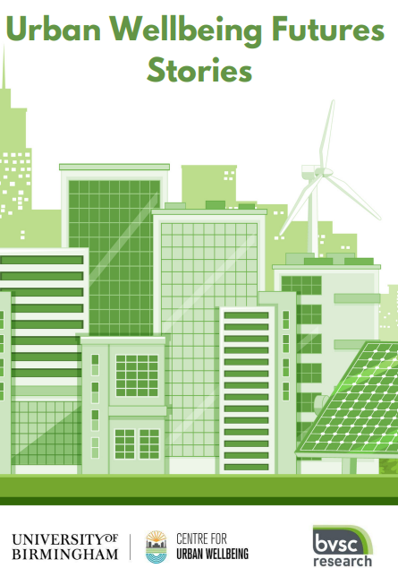

Engagement on Urban Wellbeing
Membership and Advisory board
Policy projects and fellowships
Community events
External partnerships
International Visiting Fellowships
Seminar series
Annual conference/event
Policy masterclasses
Citizens panel
Community of Practice on social prescribing
EUniwell module
Neighbourhood Futures Festival

Slide 10
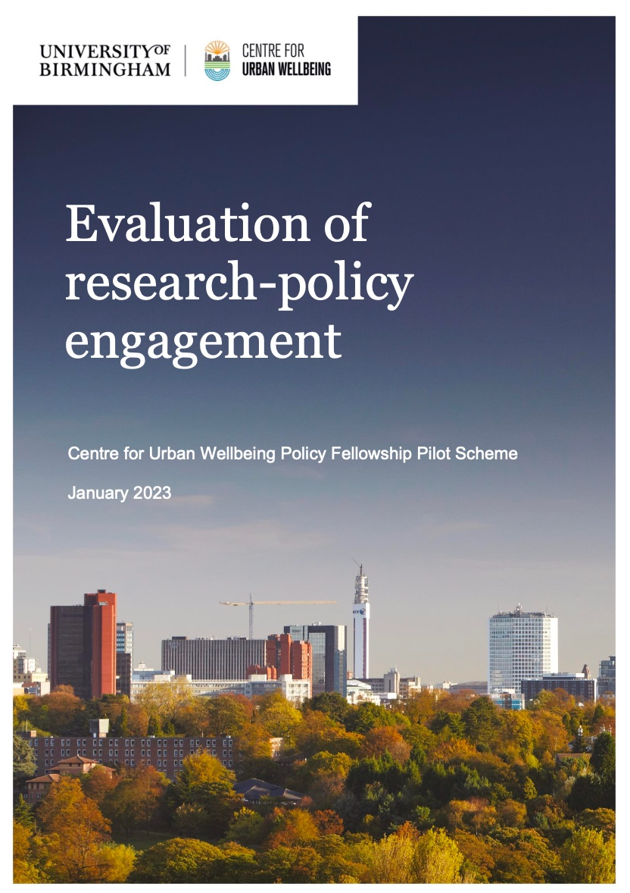
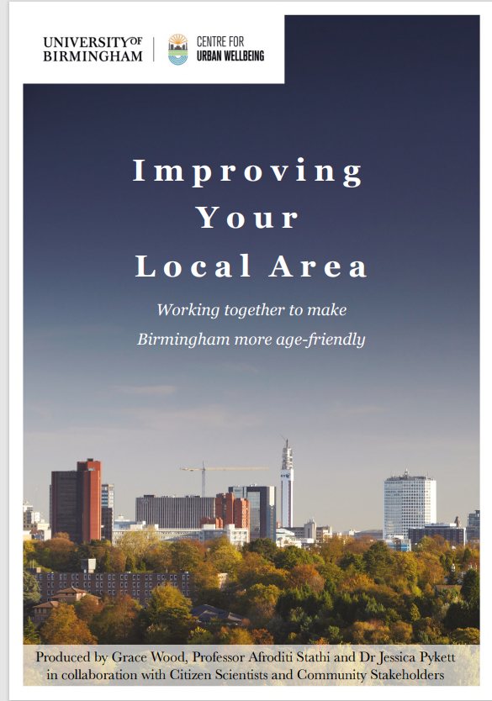
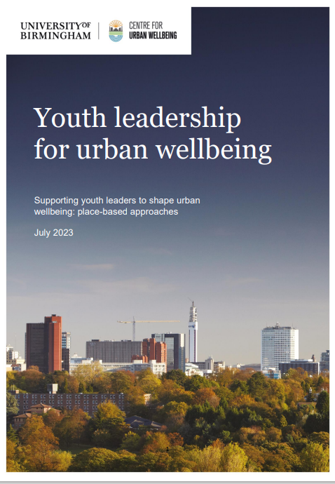
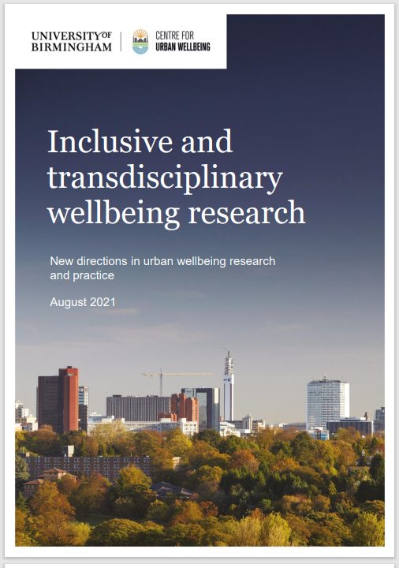
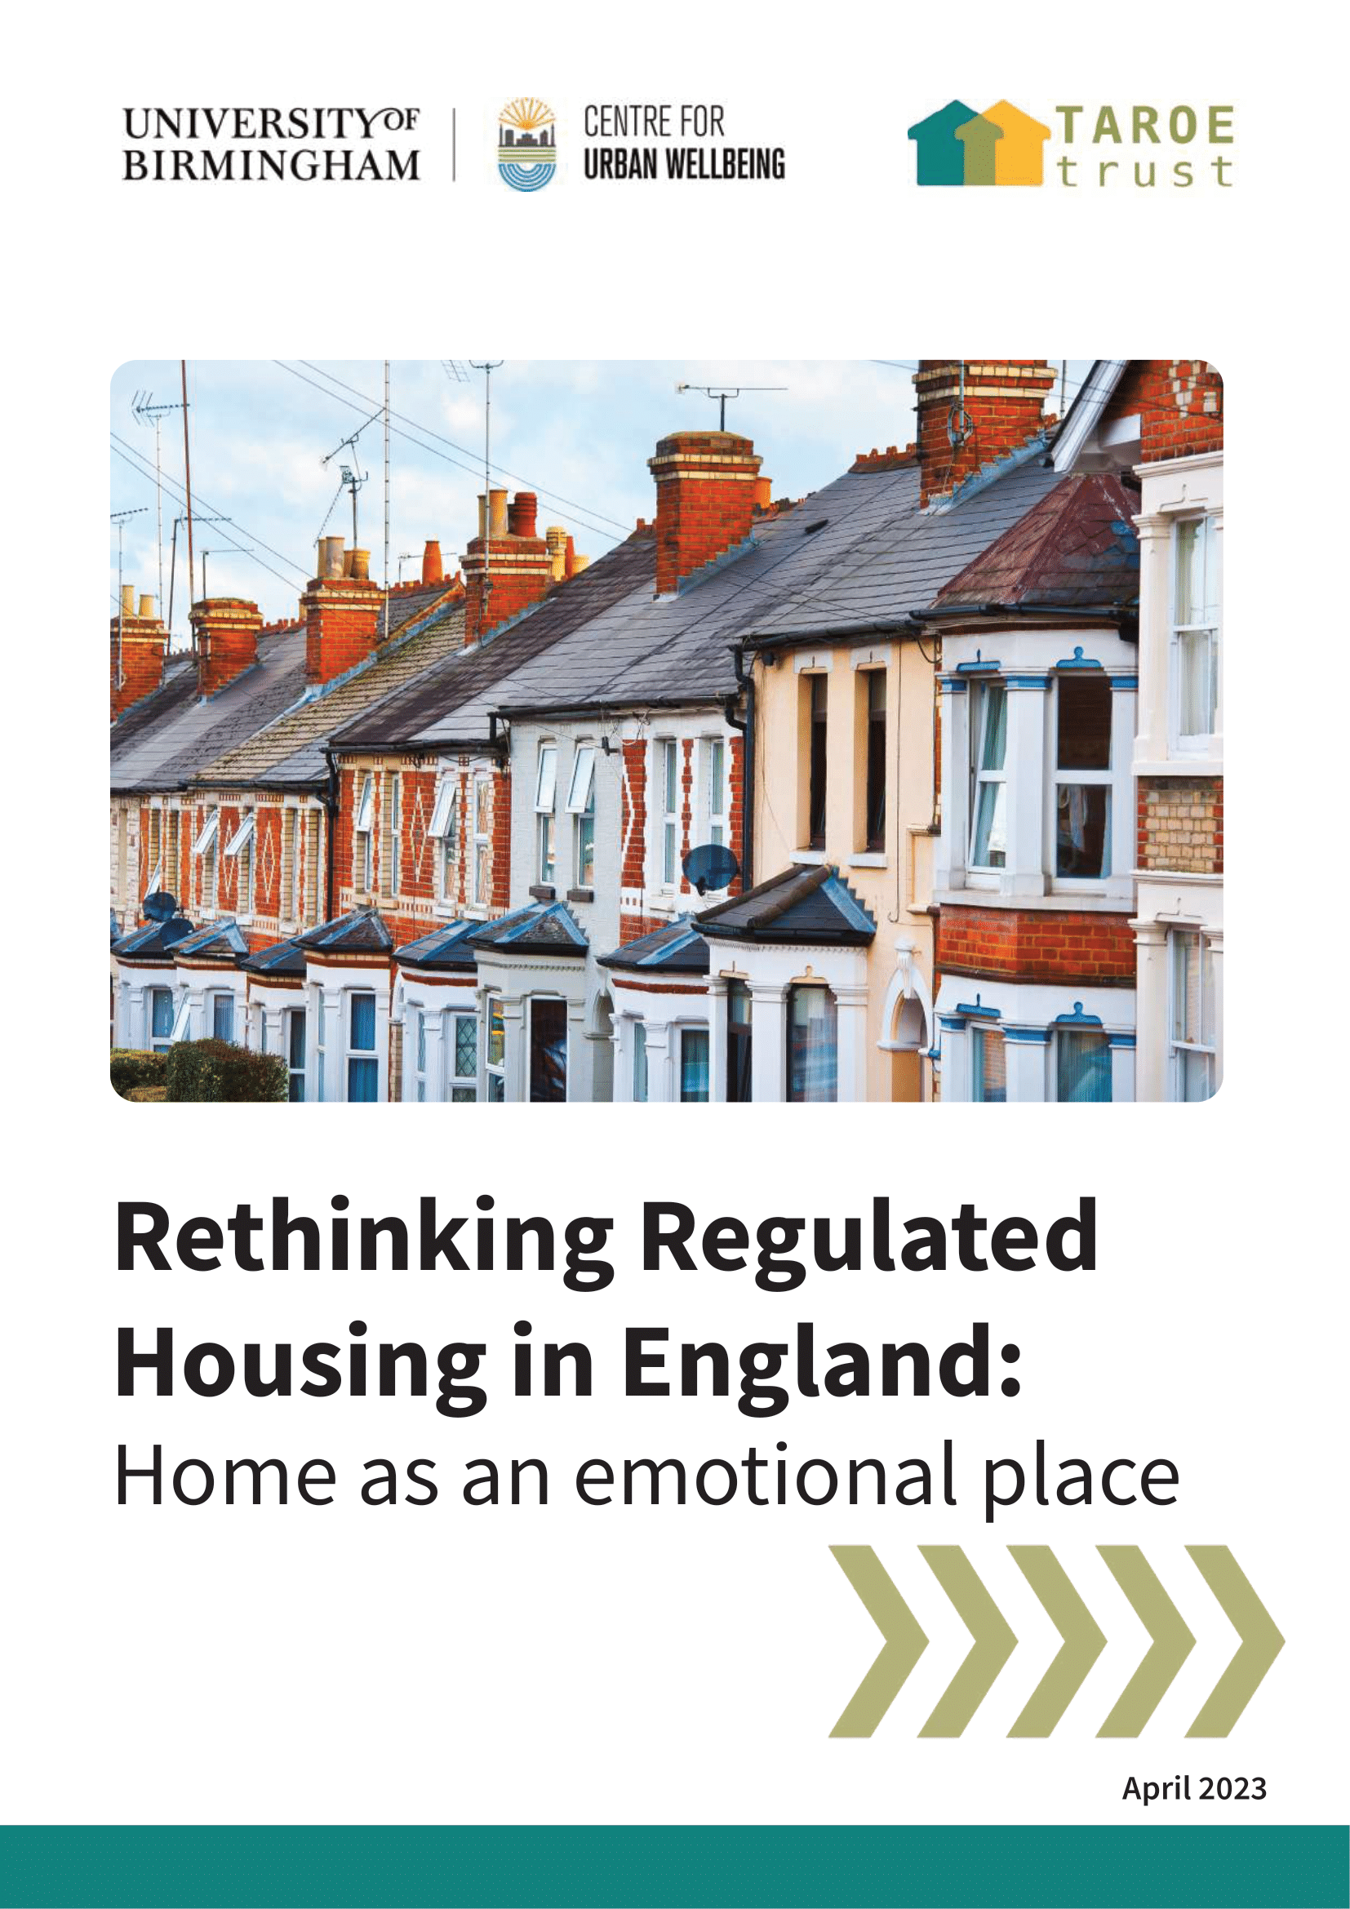
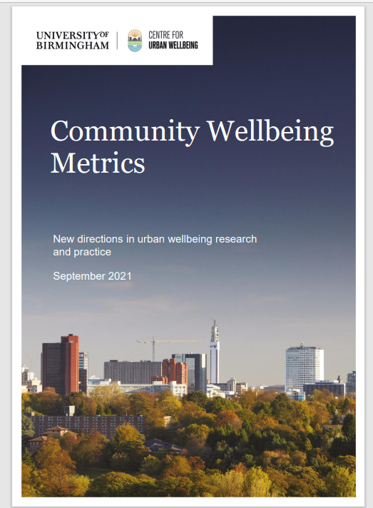
Resource hub
https://www.birmingham.ac.uk/research/centre-urban-wellbeing/home-page.aspx#

Slide 11
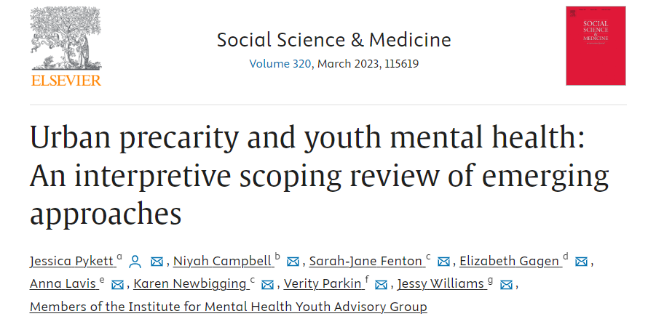
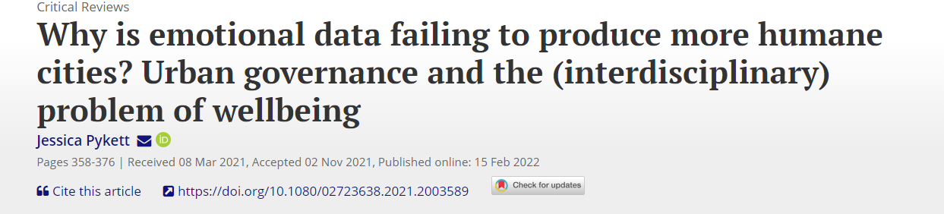
Environmental risk factors for urban mental health
Contrasting perspectives:
  Built environment
  Social and economic factors
  Biological pathways (exposure and risk), e.g. epidemiology, neurourbanism, neuroarchitecture
  Global causes and global differences
  Environmental justice debate
  Interaction of features
How is the urban defined?
  Urbanicity (population density)
  Urban form (built environment, architecture, design)
  Urban as a public sphere – emergent, contested, unstable
  Urban as everyday practices and mobilities
Poor physical environment and quality of urban spaces
Access to nature and green space (even just views, sounds)
Noise
Air pollution
Cognitive overload (overstimulation)
Housing quality and affordability (high rise buildings, floor level, tenure)
Land-use mix
Opportunities for active travel
Social capital, fragmentation and lack of social support
Lack of trust, sense of social threat
Exposure to violence
Neighbourhood deprivation
Unemployment and socio-economic status
Selective migration (social drift hypothesis)
Urban precarity (economic, social insecurity)
Social marginalisation and discrimination
Krabbendam et al 2020
Notes:
The urban is often in urban wellbeing research treated as a ‘container’ for human activity, not as an active agent or social condition of possibility.

Slide 12
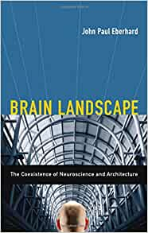
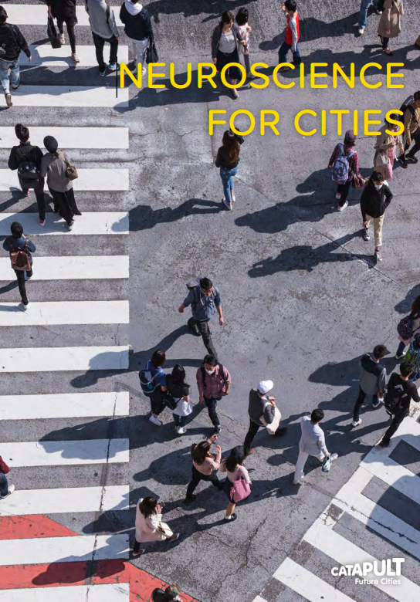
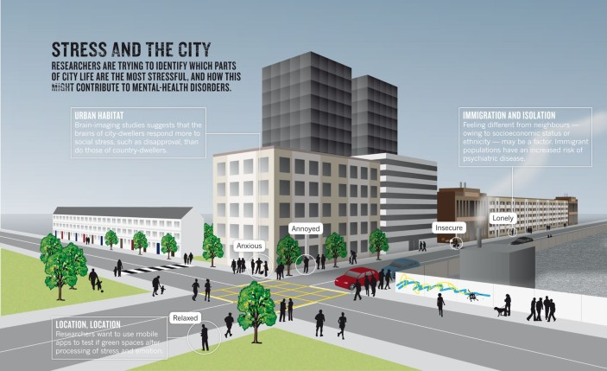
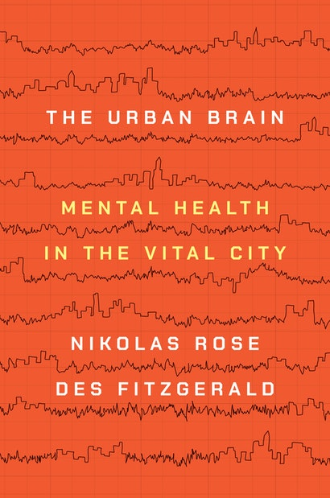
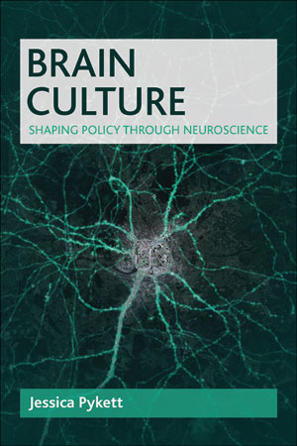
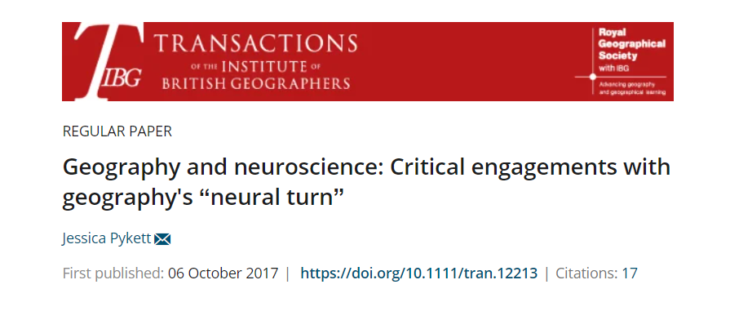
Interdisciplinary perspectives on urban mental health
Neuroarchitecture (environmental psychology, architecture)
  Neurobiological correlates of space perception, memory, orientation, learning
  Model of person-environment fit (PE)
  Methods – eye tracking, ambulatory assessment, VR ‘cave’ technologies
  Focus on memory, orientation, learning
Neurourbanism (urban planning, psychiatry and neuroscience)
  Understanding impacts, triggers, risk factors of urban living
  How the brain ‘reacts’ to city life (stress, density, noise, crowds, violence, anonymity, heat)
  Epidemiological and neuroscience methods (EEG, fMRI)
Critical neurogeography
  Cities can be both ‘toxic’ and restorative – ambiguous and contradictory
  All cities are different
  How we ‘see’ the city (through the brain) has consequences for political action
  Engages with what cities are for – and their place in reproducing capitalist relations
  Humans don’t just react to but ‘make, remake and inhabit’ cities (Rose and Fitzgerald 2022)
  Inequalities and diversity matter for urban wellbeing
Nature editorial: Alison Abbott,2011 Stress and the City: Urban decay
Notes:
Critical neurogeog
“an interdisciplinary project to engage critically with geography’s ‘neural turn’, to enrich the spatial grammars used in cognitive and affective neurosciences and to question assumptions made about (political) agency and the production of neural subjects; relational account of space”
Focus topics: ‘urban stress’, ‘urban precarity’, digital emotion sensing, data-driven urban digital phenotyping for MH

Slide 13
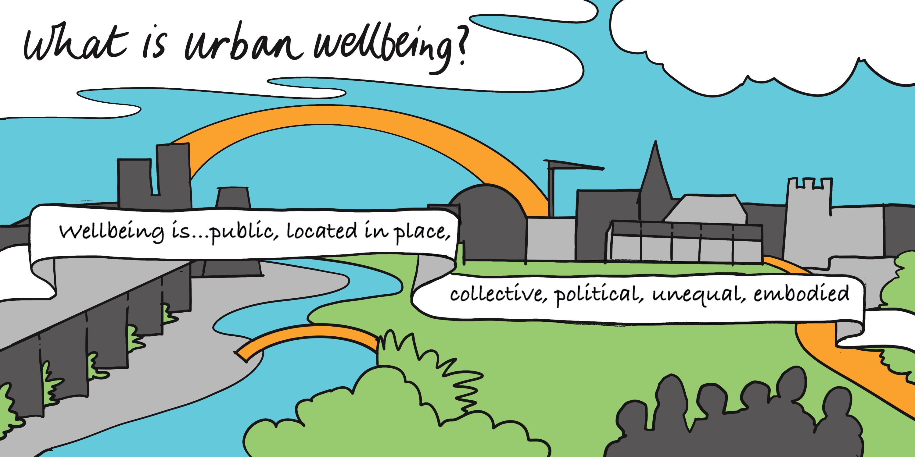
Place-based
Objective and subjective
Public/collective feelings
Practiced, not ‘achieved’
Includes but goes beyond health
Focus on purpose, meaning, fulfilment
Equalities and inclusion
Notes:
CUWb has developed a distinctive approach to understanding how wellbeing is experienced, practiced and shaped. We treat wellbeing not only as property of individuals, but of publics, places and communities, and that our research is aimed at involving people in both advancing understanding and shaping the cities in which wellbeing is experienced to make places which are more equal.
“We see wellbeing as both located in place and as a public matter. It is collective rather than individualised, political rather than neutral, and distributed in spatially uneven ways because of existing inequalities. It is also both embodied – concerned with feelings, identities, social difference and cultural norms, and environmental – related to the world around, to others, and to the public expression of feelings.” [Jessica Pykett]
We also recognise the divergent focus on wellbeing as either a place-based, regional economic problem, or a person-based individual, behavioural problem can seem to work at odds with each other. This requires that attention is paid to neglected dimensions of urban wellbeing:
How people interact with their environment
How people are invited (or compelled) to recognise the possibilities of and limits to their own personal and collective wellbeing.
How people practice wellbeing in their everyday lives
Inequalities in wellbeing within urban environments
People’s diverse aspirations for and interpretations of wellbeing
What we already know about the social conditions required to thrive
The basic connections between economic policy, environmental policy and unsustainable levels of consumption
The ways in which people, community and the urban are connected
Improving the wellbeing of marginalised groups
The sustainability of wellbeing over the long-term
How public bodies, voluntary and community organisations, and communities interact to address wellbeing
Engaging and enabling institutions in their next steps towards applying the insights from urban wellbeing research and partnering with urban wellbeing researchers

Slide 14
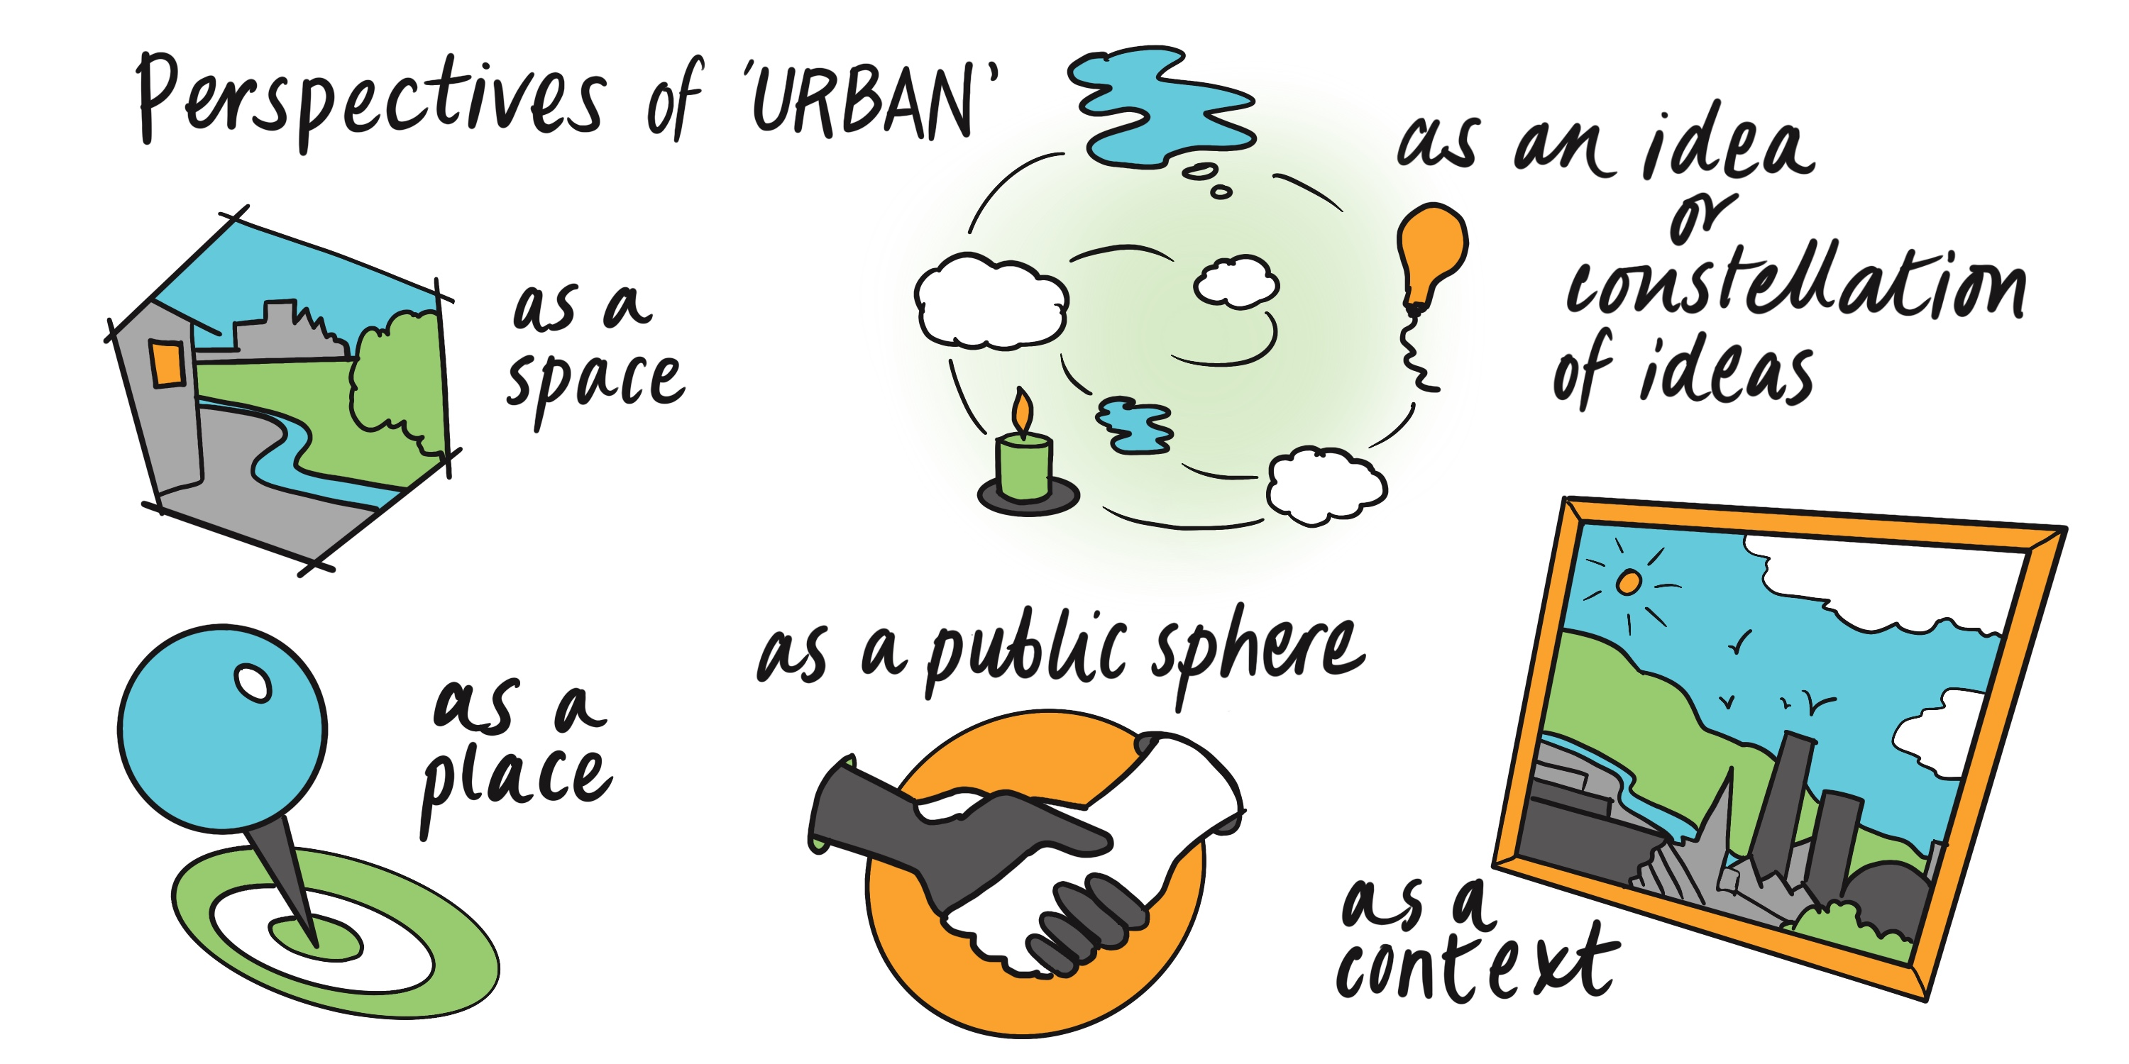
Multiple urbans

Slide 15
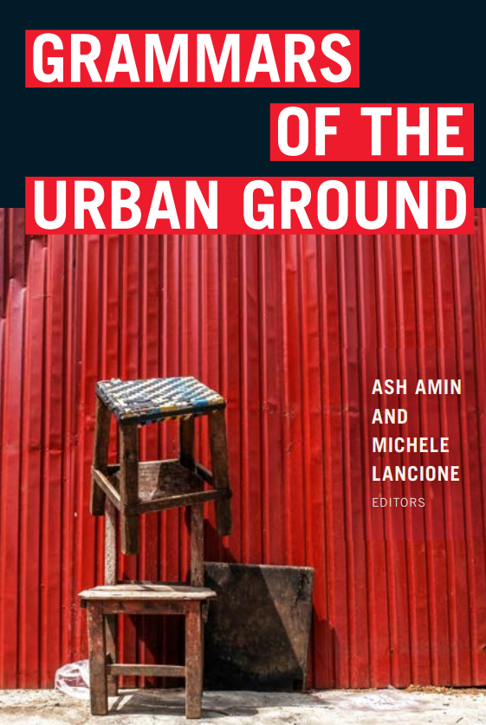
Urban repair and remediation
A need to “think cities from the ground”? (Amin and Lancione 2022: 3)
  decolonial urban scholarship and plural forms of analysis. Cities as entanglements rather than abstractions,
  unpacks urban epistemologies – “how knowledge about the ground is produced”
  Pays attention to “the horizontal, connective, and aggregative forces of city-making” for reparative action
Urban niching tactics and urban remediation
  Interdisciplinary, ethnographic research situated in communities, e.g.
  Understanding of urban atmospheres, perceptual attention, city-person interactions, coping strategies, navigational tactics (Bieler 2016),
  Proposals for urban planning and new therapies to promote recovery – through “environmental enrichment” ‘walk and talk’ groups, tailored therapies to person in their own city (Baumman, Söderström et al 2019)
  Explores the human and non-human “spaces, bodies, objects and forces” (Duff) which enable or impede recovery, and the rhythms of rehabilitation, support, setbacks, conceptualisations of mental illness and functioning
Politicising an ethic of care as an essential condition of human living, social and political life (Tronto 1998)

Slide 16
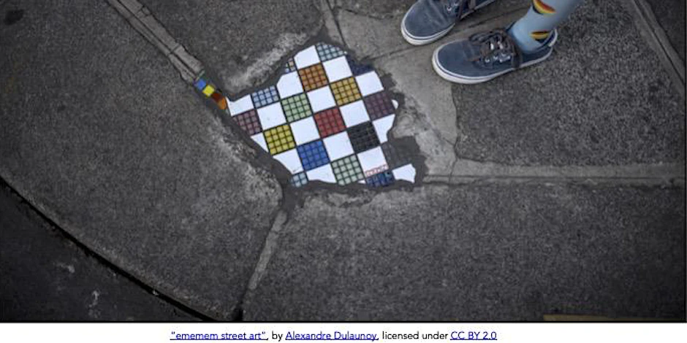
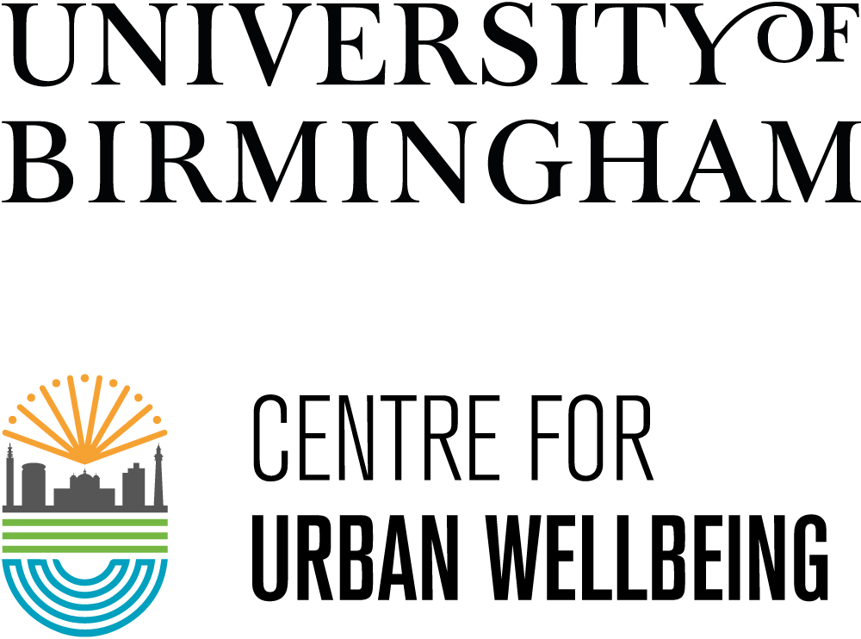
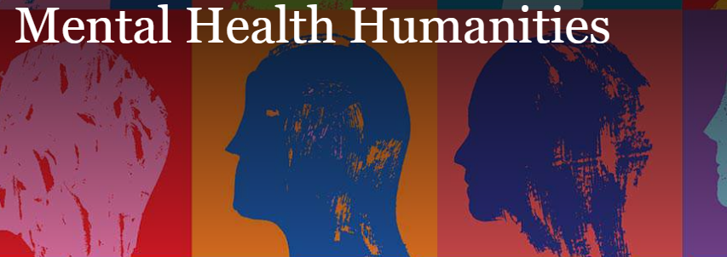

Writing the Good City
Coping, restoration and repair in urban environments
Join in Teams
Notes:
This symposium held in Dec 2022 created interdisciplinary dialogue exploring how the humanities, literary imaginations and historical representations can inform understandings of the diverse character of urban experience, individual and collective responses to the phenomena of ‘urban stress’ and ways of psychological coping, restoration and repair. It is collaboratively organised by the Centre for Urban Wellbeing, Mental Health Humanities Network and Department of English Literature at the University of Birmingham.
We heard from speakers who have examined historical precedents for the paradoxical contemporary representations of cities as both a locus of existential malaise/stress, and as a panacea for addressing global challenges such as the global disease ‘burden’ of mental ill-health. We aim to prompt discussion around questions such as, how are urban environments implicated in shaping mental life, behaviour and personal relationships for specific social groups, how are they seen as risky or ‘toxic’ spaces, and what opportunities do cities pose for cultivating repair and restoration for precarious lives?
While some social science attention has been paid to the mental health impacts of the urban built environment, migrant experience, ‘regimes of attention’ and the spatial politics of mental healthcare access, there is also value in considering the visual, material and emotional cultures of cities, including how they are represented. In what ways do cities confer particular psychological values and virtues and how do specific places and spaces offer environments which are curative and therapeutic? How do and have technological innovations intervene(d) in the space of the city and our multi-sensory experiences of it? Whose subjectivities are represented in the urban landscape, who is excluded, and how are dominant cultural representations of cities shaping our expectations for urban living?
There we heard from historians and English literature scholars
Literature professor Anna Snaith spoke about post war campaigning around noise pollution- acknowledged today by WHO as the main urban stressor, during this period was seen as a need to soundproof the city and prevent ‘nerveforce’ of urban din, but ultimately used as a way of enforcing class divisions, and the ‘anti-noise league’ of London was associated with eugenics
Historian Ed Ramsden spoke about group of social scientists from UK and USA who also postwar were known as the ‘Space Cadets’ – the “committee on physical and social environmental variables as determinants of mental health” – led to public housing building standards, sanitation programme, measures on ventilation, crowding, noise, open space, minimum housing space standards – still a problem today. He pointed out that the focus on planning and urban design was valid and useful but detracted from the harder issues that needed tackling – poverty, inequality and unemployment
Bringing it up to the present day we heard from medical anthropologist Natassia Brenman who spoke about how voluntary sector providers feel they have become ‘dumping grounds’ for vulnerable people providing essential MH services always negotiating keeping people in vs out of care
Really fascinating to think about the ‘urban wellbeing agenda’ through the lens of previous attempts to tame, manage and govern the emotions, movement and attention in urban space.
Doing this we hope will open up the imagination on what kinds of ‘mentally healthy’ urban worlds are desirable and possible.
Building a social and imagination infrastructure - the solution and role of place-based community and civic sector orgs in this, econ security…wellbeing economy
How do we shift the community development and service provision landscape from “what is wrong with you?” to “What do you need” (Strengths/assets vs intervention)
This raises an unresolved set of questions of how to find out, represent and advocate diverse community voices, stories and testimonials.

Slide 17
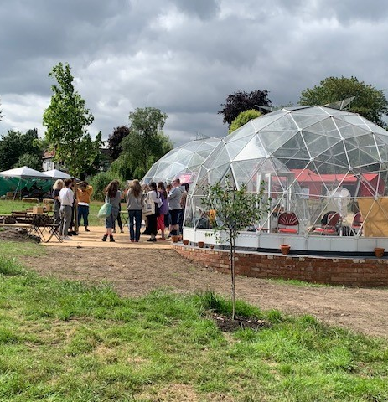
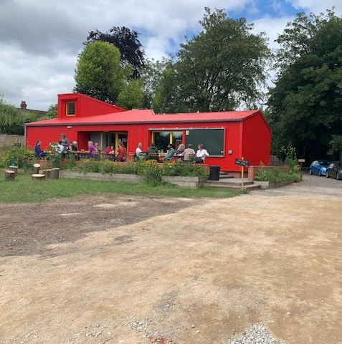
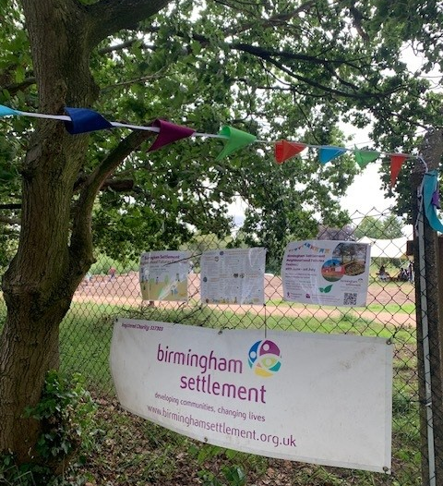
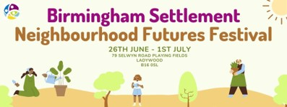
Notes:
This led us to a partnership with Birmingham Settlement, a charity with a very long historical association with Uni of Birmingham. Birmingham Settlement was founded in 1899, one year before the University of Birmingham (Glasby 1999). At this time, the founders and staff at Birmingham Settlement were involved with giving lectures at the University, hosting renowned social reformers such as Beatrice Webb, and founding the first ever social studies lectures. This influenced many generations of social workers.
We co-organised their first ever Neighbourhood Futures Festival. This was a week long programme of events, talks, activities held at their new Edgbaston Reservoir Nature and Wellbeing Centre in Birmingham. The site is a 40 minute walk west from the City Centre.
This emphasis on enrichment through writing, imagining and reshaping the city is evident in the kind of talks and workshops UoB are offering here- some highlights:
collab between artist and environmental scientist on visualising air pollution to prompt action (Tues)
imagining mental health recovery as a route to citizenship (Tues)
Drawing ‘rich pictures’ to think about civic participation and involvement in local democratic action
rethinking our cultural relationship with the motor car, historical perspective (Wed)
a writing workshop with former poet laureate of Brum – Spoz (thurs)
with performing arts company the future places toolkit -reimagine the future through AR experience (Sat)
I.e. lots of storytelling and participation, collective action - research involvement itself can be enriching – AIM: can we push the horizons of possibility on what is a good city?

Slide 18
Aims
Festival Aims
Research Questions
Support and generate a new way for community organisations to work across the city to connect community wellbeing, green spaces and sustainable action.
Make new connections and act as a springboard for community organisations to be empowered to act in their neighbourhoods.
Involve local people in community-based activity, increase participation and pull people back together in the neighbourhood following the Covid-19 pandemic.
Give an opportunity for people who may not have yet seen themselves as part of the solution to the climate crisis to shape the city’s net zero agenda
What are the best methods for engaging with local community members and organisations for planning an annual Festival event?
How can the Neighbourhood Futures Festival build sense of community, inclusion and belonging, social connection, trust and collective action?
How could Edgbaston Reservoir Nature and Wellbeing Centre shape nature connectedness and wellbeing for future community organising on sustainability?
Notes:
Our aim was to help to make community connections and support local participation in activities to improve community wellbeing and sustainability.
The festival aim was to
Support and generate a new way for community organisations to work across the city to connect community wellbeing, green spaces and sustainable action.
Make new connections and act as a springboard for community organisations to be empowered to act in their neighbourhoods.
Involve local people in community based activity, increase participation and pull people back together in the neighbourhood following the Covid-19 pandemic.
Give an opportunity for people who may not have yet seen themselves as part of the solution to the climate crisis to shape the city’s net zero agenda
We conducted action research to support and evaluate the festival.
Birmingham Settlement staff were involved in setting the issues to be researched, and as part of a longer involvement will have opportunities to learn new research skills such as administering surveys, running focus groups and engaging in creative storytelling research methods. They will play a lead role in designing and implementing actions.
The research priorities of the Centre for Urban Wellbeing have been shaped by consultation with over 30 community and voluntary sector organisations, wellbeing researchers and local authorities, and is organised around five key areas:
Healthy living environments including mental wellbeing, stimulating, safe environments and social interaction
Income inequalities including access to finance, early years care, education and employment
Evidence to inform incorporating wellbeing into urban planning strategies
Access to and use of nature and green spaces, and tackle land ownership inequalities
Challenging the underlying economy and its assumptions including growth of consumption and production at all costs
As part of the wider Urban Wellbeing in Policy project, our research has been looking at developing and evaluating ways of involving community groups and residents in research which could shape policies for tackling urban wellbeing inequalities in the region.

Slide 19
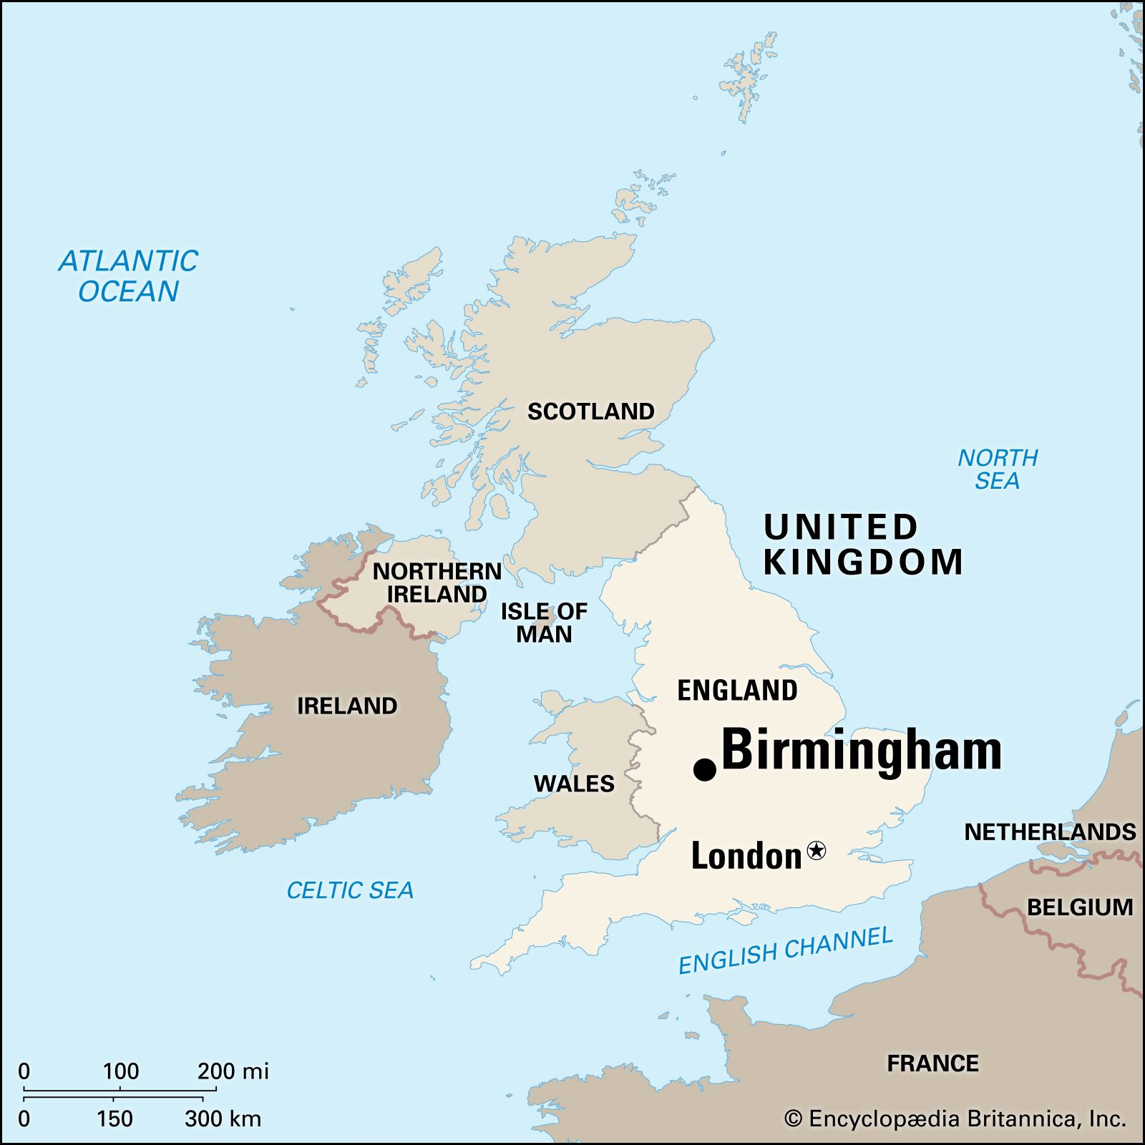
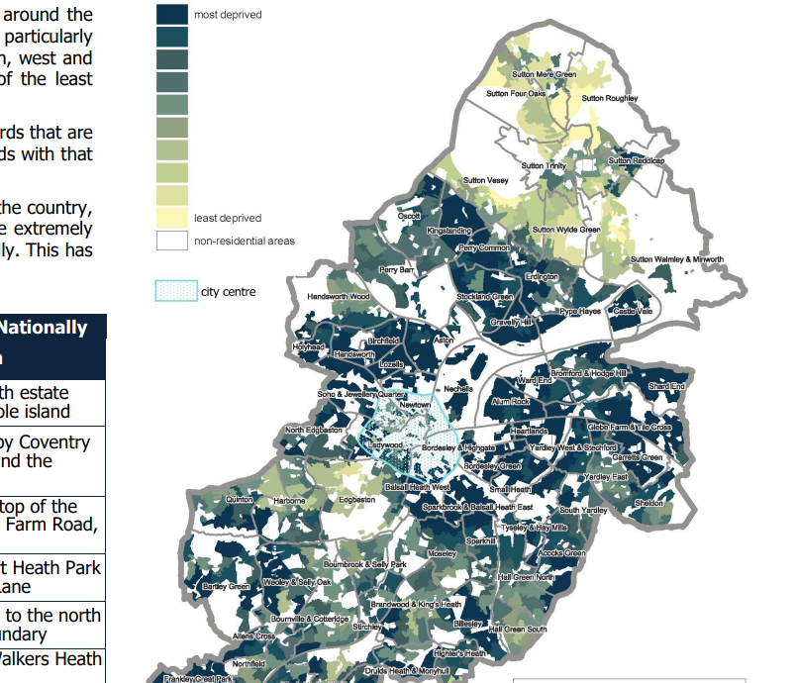
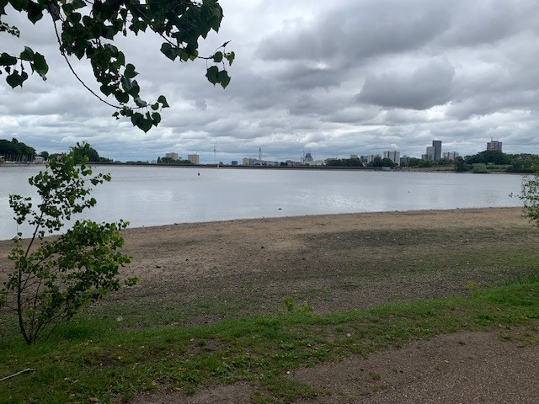
Site and context
Index of Deprivation 2019. Source: Birmingham City Council
Most deprived
Ladywood and North Edgbaston have a high level of social isolation, youth unemployment, religious and ethnic diversity, a skills gap
Area is characterized by urban development pressures for unaffordable housing
Conflict over the future uses of the Reservoir and its surroundings
Opportunity for the radical re-use of green space for public benefit

Slide 20
Role of community festivals in shaping urban wellbeing
Potential positive impacts of community festivals:
revenue-generation for community groups
economic impacts in the wider area
place-making, pride
improved quality of life for families
improved wellbeing for volunteers
sense of connection and reciprocity (Jepson et al 2019; Brownett and Evans 2020; Coren et al 2022)
But can:
mask inequalities
create spectacles which obscure urban marginalisation and injustices
promote “cities as consumer playgrounds” (Waitt 2008)
Lead to local conflict
Community control is shaped by:
  neighbourhood connections
  decision-making influence
  developing community capabilities
  community tensions, conflict and power imbalances
  availability of funding and sustaining collective action
New Local and What Works Centre for Wellbeing 2023
Notes:
Some quite good evidence on what kind of place-based interventions are effective at improving community control and agency (WWCW)
Community festivals have rarely been researched as interventions.
We need to know more about how they might improve community control. How do we ensure the positive impacts and reduce the negative?
How can we make sure they’re not one-off events but having lasting impact?

Slide 21
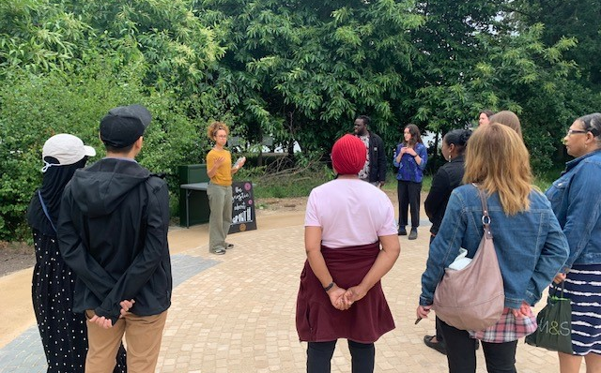
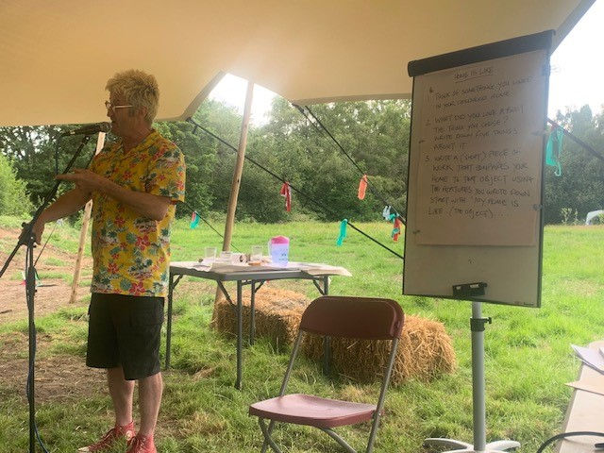

Community-engaged Action Research
Methods:
Asset mapping
Demographic portrait
Evaluation survey
Wellbeing, nature connection and social connectedness survey
Participant Observation
Creative participatory methods (rich pictures, storytelling anthology, mindful walking, augmented reality)
Feed forward workshop
Notes:
Why do it?
Because asking people about their experiences, what they are thinking, and how they imagine the future are all ways to break out of a ‘stimulus response’ model of human behaviour and activity. Learning from historical precedents for thinking of the city as a biological system and of the emotions as a source of economic value – how is urban wellbeing evidence and knowledge being used in policy and governance, and how can we pluralise this?
Because engaging in forms of public pedagogy has the potential to change aspirations, connect people, build stronger communities, convene publics to hold political decision makers to account
Urban humanities approach which redefines the city as “situated collective life emplaced in an urban context, comprised of historical interpretation, material environments, contemporary culture, and speculative futures” (Cuff and Wolch 2020/22)
What is a humane city? What about the non-human? Materialities, embodied methods, more democratic methods
It is not always successful, and can be harmful

Slide 22
Selected findings
Social connection: “I got to speak to other residents of the area who had great ideas about the neighbourhood”, “I learned about other people’s perspective on life and work”.
Community agency: “Lots of exciting ideas about community climate action - ways we can work together and support each other to mobilise”. “how communities can do much more to help each other”. BUT participants felt that neighbourhood and city-wide planning consultations were not effective in meaningfully gauging resident viewpoints and felt ignored by formal processes.
Nature connection and wellbeing: “we don’t have to lose hope, keep blooming like flowers”, “we are more connected and living in the future we dreamed about”, “the ideas/ love between mental health and gardens”.
Place ownership and belonging: “I got the impression that a lot of people were taking it all in, some for the first time, and were surprised by the setup of the site and what was available.” There were no strict boundaries between staff, clients or service users, and volunteers.
Future Places: a “place of diversity and unity”, “flexible and open”, “a place for sharing of food, resources and ideas”, and “a non-hierarchical space”, a place to learn about sustainability and organise to act on climate crisis
Sample of 37 participants from over 1000 festival visitors
Notes:
Limitations
Not all of our engagement methods were successful in generating research data or attracting attendees.
Limited sample size, and surveys provide a very limited snapshot. Using student volunteers as participant observers was challenging in terms of skill levels and the (lack of) art of noticing significant interactions, atmospheres, embodied experiences.
Involvement in the logistics of organising festival meant we weren’t just focussed on research, we had a lot of other duties
We’ve not yet analysed the more psychological survey on wellbeing, nature connectedness and social connection.
BUT
Stories, informal conversations and spending the week with others in outdoor spaces proved productive in gathering a lot of different perspectives. Some of the richest personal stories were gathered through the poetry and sustainable cities discussion sessions. W
We were able to develop a set of 6 key recommendations for Birmingham Settlement to inform their future strategic priorities.
We built strong relationships with partner organisation and community members which outlast the research.

Slide 23
How and why to reach communities
If we want to understand and intervene in the politics of urban wellbeing from the perspective of situated collective life…
To demonstrate the value and impact of social infrastructure and its role in filling the gaps left by decades of austerity in the UK – as a community sector and its physical spaces
The community sector and public sector are increasingly fragmented and competition is encouraged – this ‘symbiotic power’ is unstable and more co-operation is needed (DeVerteuil et al 2020).
Role of green spaces in improving inter-cultural connection needs more research (Hollins et al 2023:37).
Social innovators are supporting collective, anticipatory forms of imagination (the “imagination infrastructure”- Joseph Roundtree Foundation) but little is known about how to assess their impact on serving community needs and distribution of funds.
Little research exists on how to sustain successful community based participatory research over the long term (Brush et al 2020)
Notes:
There’s a lot of community research going on. It’s methods and skills are often not highly valued across the academy and in specific disciplines
We need to know more about ….
From Brush et al (community health, nursing, Detroit): what success looks like
Expanded relationships of mutual trust, knowledge retention and transfer/influence beyond the partnership
Achievement of outcomes/accomplished what aimed to do
Fair allocation of resources
Personal enrichment
Long-term commitment to the partnership
Intangibles associated with partnership over and above outcomes (such as, genuine friendship, good will, high level collaboration, acceptance)
Good governance mechanisms for dealing with conflict
Can also add:
Increases capacity and skills of community partners
Generates knowledge and action to influence policy, urban wellbeing outcomes and inequalities

Slide 24


Get involved
Come along to our seminars and events
Suggest a speaker, theme or host a workshop
Collaborate on research funding bids - engage with our network of policy and practice partners
Join as an academic associate member
Host a visiting fellow for 3 months or 1 year at your institution
Join us as a visiting fellow to develop your research
Offer a student placement at your organisation
Subscribe to our monthly newsletter
Contact details
Email: urbanwellbeing@contacts.bham.ac.uk
Website: https://www.birmingham.ac.uk/research/centre-urban-wellbeing/home-page.aspx
Blog: https://blog.bham.ac.uk/cuwb/

