Slide 1
Urbanization, Cities, and Deep-Decarbonization Nexus What it Means to Limiting Warming to 1.5⁰C?
12 OCT 2023 - 13 OCT 2023
Shobhakar Dhakal, Ph.D.
Professor, Department of Energy, Environment and Climate Change
Asian Institute of Technology, Thailand
Shobhakar@ait.ac.th; Shobhakar.Dhakal@gmail.com

Slide 2
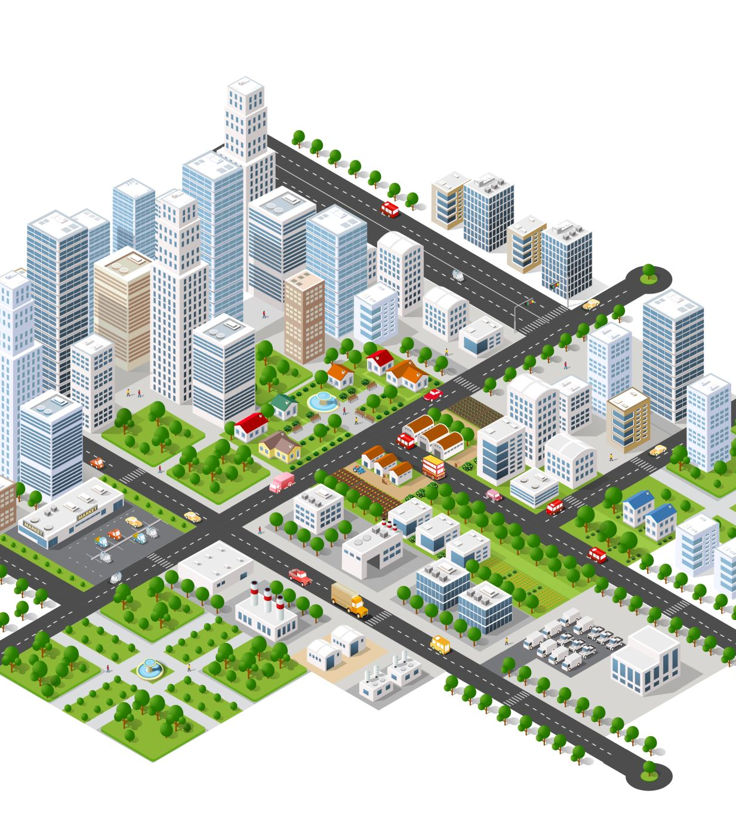
Contents
The question of GHG mitigation urgency for limiting warming to 1.5⁰C
Role and potentials of cities/urban areas/urbanization in deep decarbonization pathways
Urban climate actions and its efficacy
Key opportunities for transformative change and needs for systems approach

Slide 3
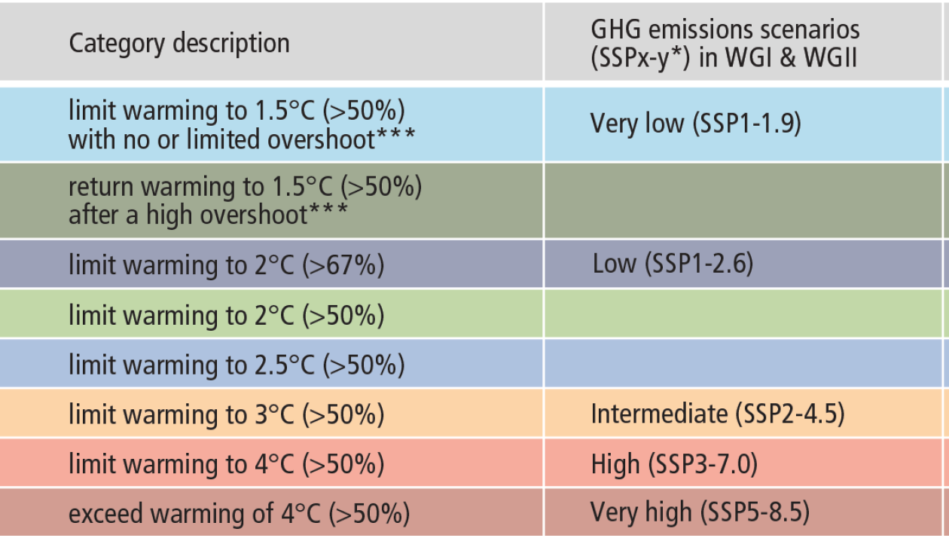
The extent to which people born in 1950, 1980 and 2020 will experience a hotter world in their lifetime
SSP5- 8.5 ~exceed warming of 4⁰C
SSP3- 7.0 ~ limit warming to 4⁰C
SSP2- 4.5 ~ limit warming to 3⁰C
SSP1- 2.6 ~ limit warming to 2⁰C
SSP1- 1.9 ~ limit warming to 1.5⁰C
Changes in annual global surface temperatures (relative to 1850–1900), are presented as ‘climate stripes’,
IPCC-AR6-SYR-SPM
20 March 2023
Notes:
IPCC reports have shown that world has already warmed by about 1.1°C warmer than it was in pre-industrial times (1850-1900).The temperature has increased faster since 1970 and this recent rate of warming is unprecedented in at least 2000 years, and probably considerably longer. Human-caused greenhouse gas emissions are the main driver of global warming. You see ‘climate stripes’ here. It clearly shows how global average temperatures have risen over the time. Each stripe represents the average temperature for a single year, relative to the average temperature over the period as a whole. The stark band of deep red stripes on the right-hand side of the graphic show the rapid heating of our planet. This illustrate how the climate has already changed and will change along the lifespan of three representative generations (born in 1950, 1980 and 2020). Future projections are shown for different GHG emissions scenarios.
Climate change will be further felt not in far future but already and more aggressively very soon in this generation.

Slide 4
Notes:
Let me first address the question of urgency. Emissions of greenhouse gases have continued to increase since 1990, reaching 59 GtCO2e in 2019. This is about 12% (6.5 GtCO2-eq) higher than in 2010 (53 GtCO2-eq) and about 54% (21 GtCO2-eq) higher than in 1990 (38 GtCO2-eq). Of this about two third comes from energy use.

Slide 5
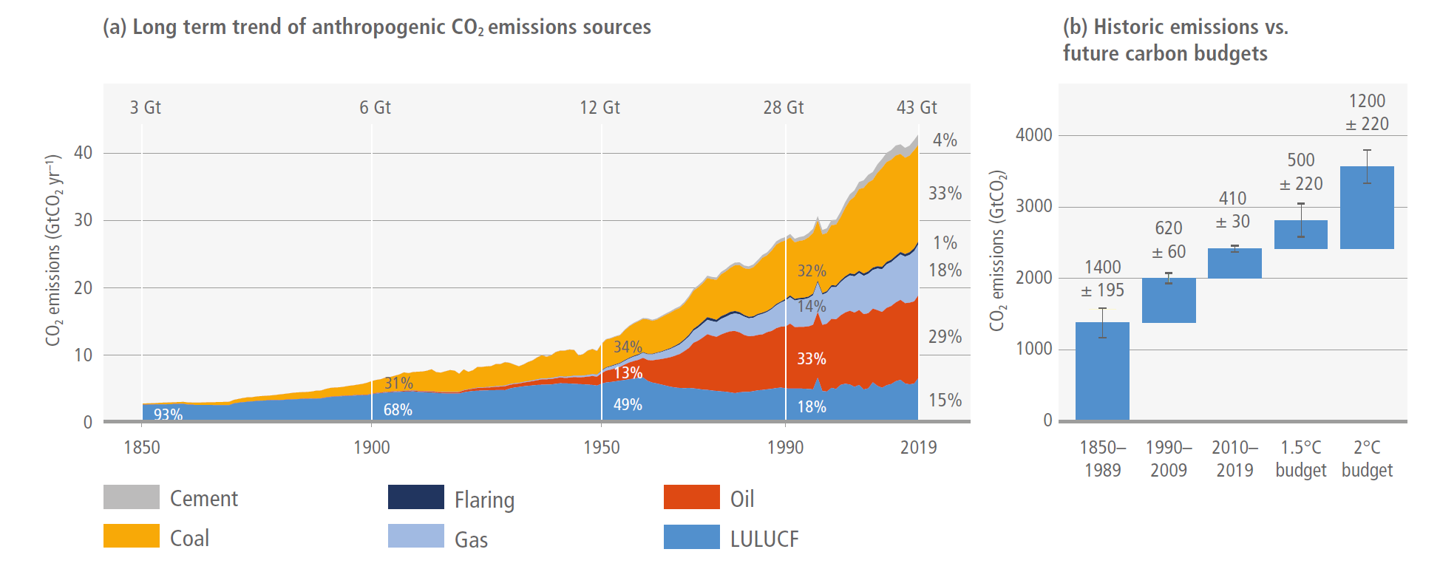
Historic anthropogenic CO2 emission and cumulative CO2 emissions (1850–2019) and remaining carbon budgets for limiting warming to 1.5°C and 2°C
Cumulative net CO2 emissions of the last decade (2010–2019) are about the same size as the remaining carbon budget for keeping warming to 1.5°C →WE ARE NOT ON TRACK TO LIMIT WARMING TO 1.5°C.
Notes:
IPCC’s 6th Assessment Report have shown that, remaining carbon budget for limiting warming to 1.5C is only about 500 GtCO2 which is about the same size of what we emitted in the last one decade (2010-2019). This means that we are not in track to limit warming to 1.5C.

Slide 6
IPCC-AR6-SYR-SPM
20 March 2023
by end of 2021
For limiting warming to 1.5°C CH4 are reduced by 34 [21–57]% by 2030 relative to 2019
Notes:
The sharp reductions are needed not only for ‘long term’ but more importantly for ‘near term’. Scenario consistent with 1.5 degree warming shows the needed reduction in GHG by 48% in 2030, or 43% for CO2. Needed GHG reduction in 2050 amounts to 84% of GHG or 99% CO2 from 2019.
These are tall orders that policy makers must confront and address.

Slide 7
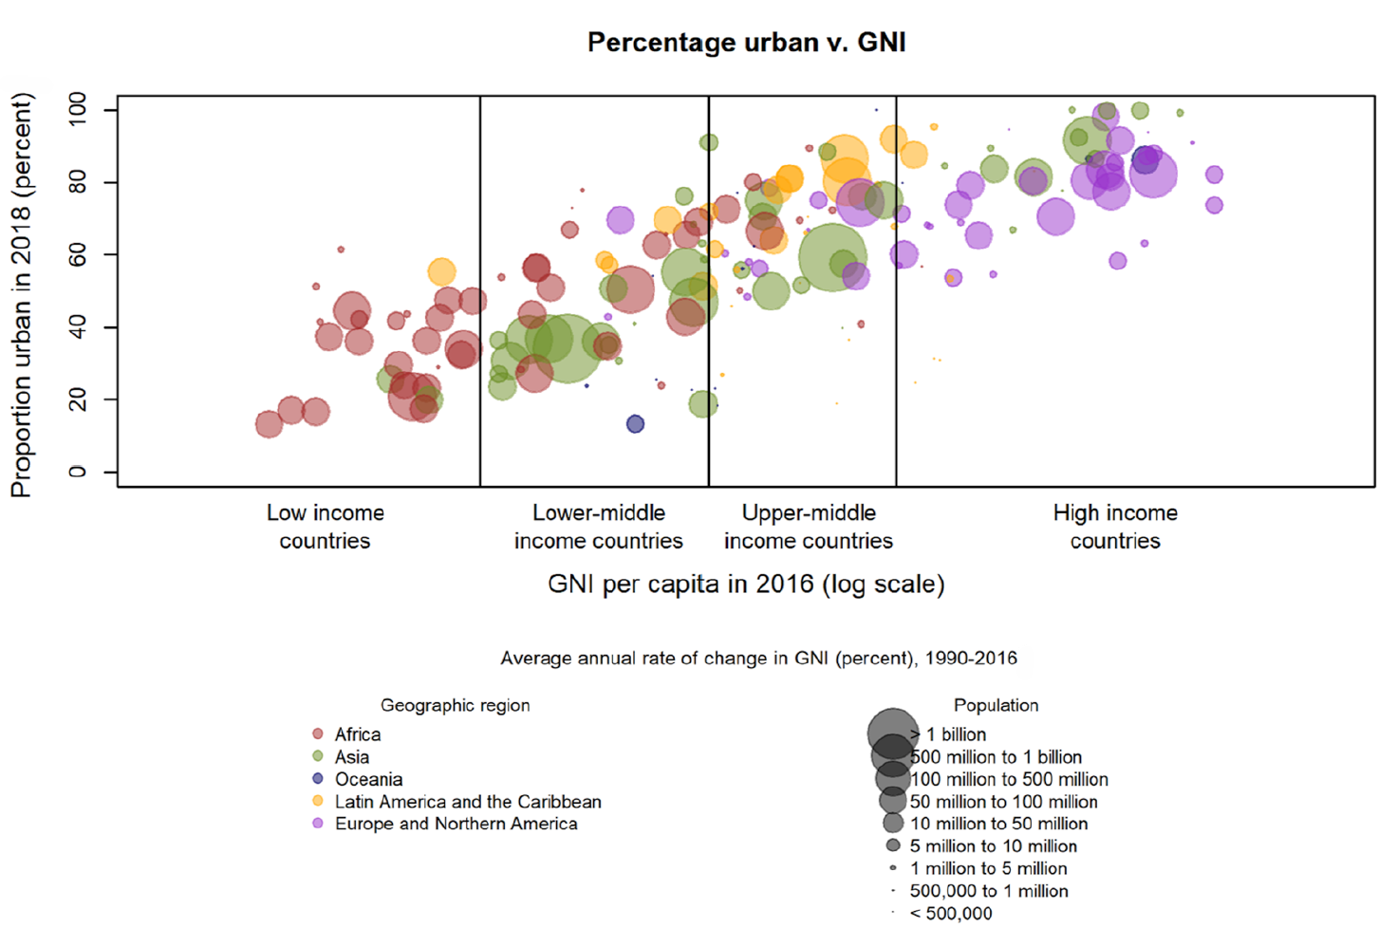
Urban in context
Relationship between urbanisation level and gross national income
4.2 billion people, 55% of global population
Low levels of urbanisation, on average 30%
High levels of urbanisation, on average 80%.
Population by area of residence and size class of urban settlement for 2018
Half of the world’s urban population lived in seven countries in 2018 (Russia, Japan, Indonesia, Brazil, USA, India, China)
Many studies show that the relationship between urbanisation and emissions is dependent on the level and stage of urban development, and follows an inverted U-shaped relationship of the environmental Kuznets curve
Lwasa et al. (2022). Urban systems and other settlements. In IPCC, 2022: Climate Change 2022: Mitigation of Climate Change. Contribution of Working Group III to the Sixth Assessment Report of the Intergovernmental Panel on Climate Change . Cambridge University Press, Cambridge, UK and New York, NY, USA. doi: 10.1017/9781009157926.010
Notes:
In that context:
Over 55% of world population is already urban, about 4.2 billion in 2018
Rate of urbanization has a clear correlation with the stage of income which in-turn is correlated to emissions
Half of the world’s urban population lived in seven countries in 2018 (Russia, Japan, Indonesia, Brazil, USA, India, China). Urban residents in many of them and others are expected to drive emissions.
We have dual challenges – at one hand, reducing per capita emission in developed country cities and matured cities, and in another hand, finding urbanization paradigm or pathway that is less carbon intensive in emerging cities and where income and urbanization has seen rapid growth.
Many studies show that the relationship between urbanisation and GHG emissions is dependent on the level and stage of urban development, and follows an inverted U-shaped relationship of the environmental Kuznets curve

Slide 8
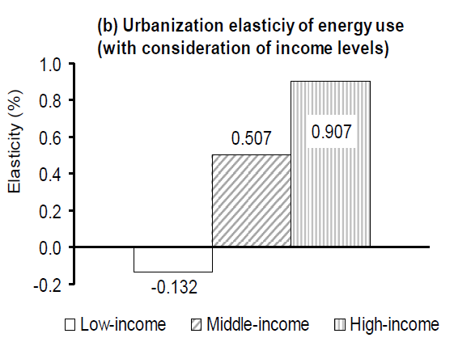
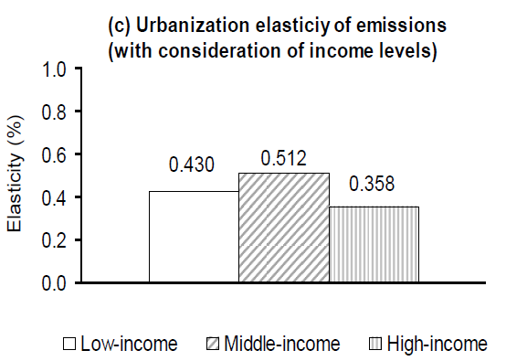
Urbanization led to increase global CO2 emissions in the past
Effect of 1% increase in urbanization
Stochastic Impacts by Regression on Population, Affluence and Technology (STIRPAT) model and a sample of 88 countries for the period 1975–2005
Poumanyvong and Kaneko, 2010, Ecological Economics.

Slide 9
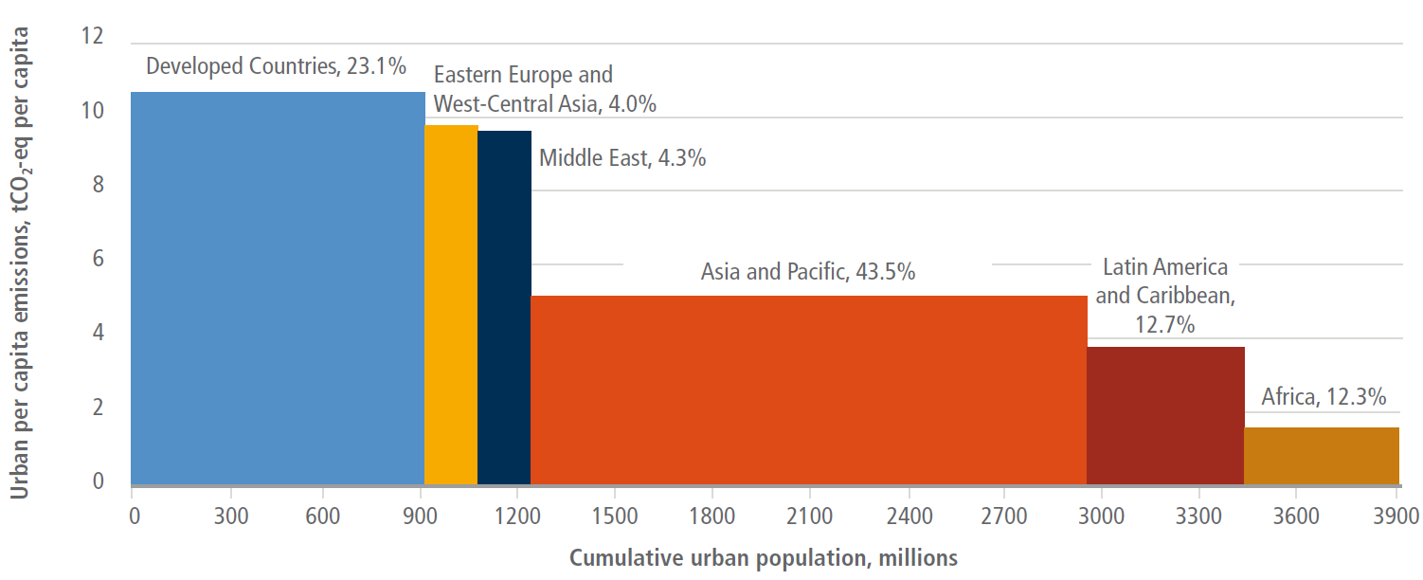
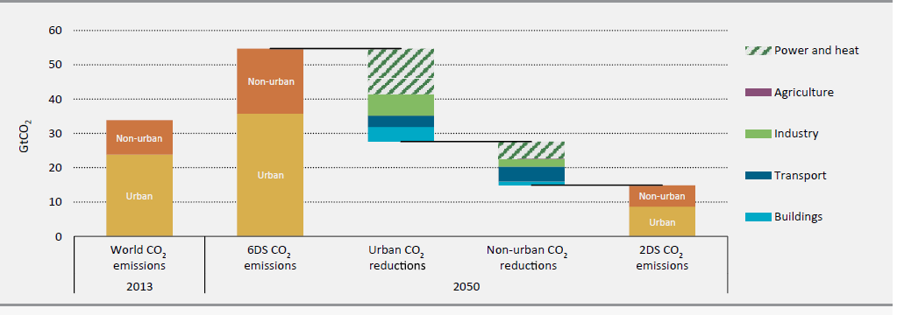
Cities’ contribution to GHG emissions
Over 70% of global energy related CO2 emissions from cities now (Seto et al, 2014; IPCC AR5) → Asian cities play a key part (IEA, 2008, 2016)
In 2020, estimated urban emission is @29 GtCO2-eq (67–72% of the global share) and about 100 of the highest emitting urban areas account for approximately 18% of the global emissions** (IPCC AR6, 2022)
Lwasa et al. (2022). Urban systems and other settlements. In IPCC, 2022: Climate Change 2022: Mitigation of Climate Change. Contribution of Working Group III to the Sixth Assessment Report of the Intergovernmental Panel on Climate Change . Cambridge University Press, Cambridge, UK and New York, NY, USA. doi: 10.1017/9781009157926.010
IEA (2016)
** These estimates are based on consumption-based accounting, including both direct emissions from within urban areas, and indirect emissions from outside urban areas related to the production of electricity, goods, and services consumed in cities. It covers CO2 and CH4
Notes:
Many studies have shown that urban areas contributes over 70% of global emissions. Cities in Asia are crucial part of that.

Slide 10
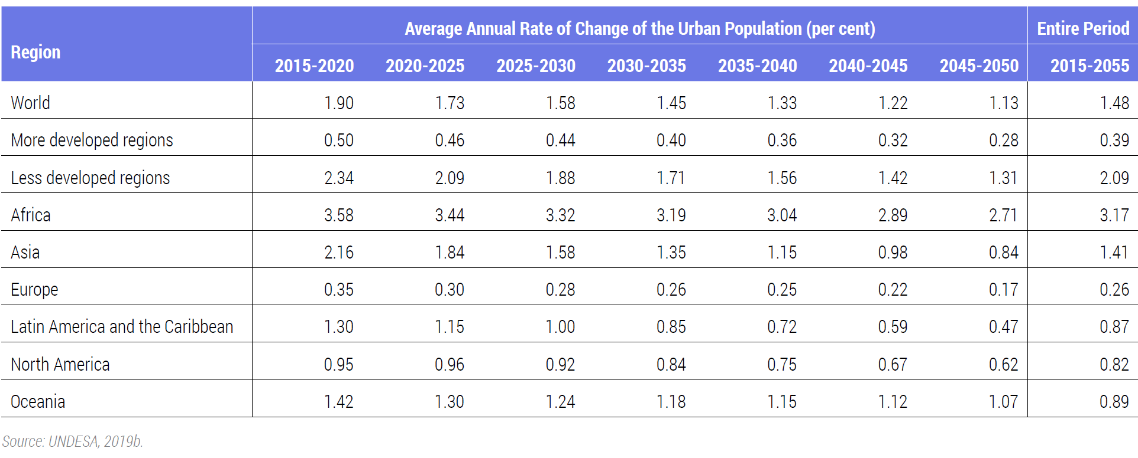
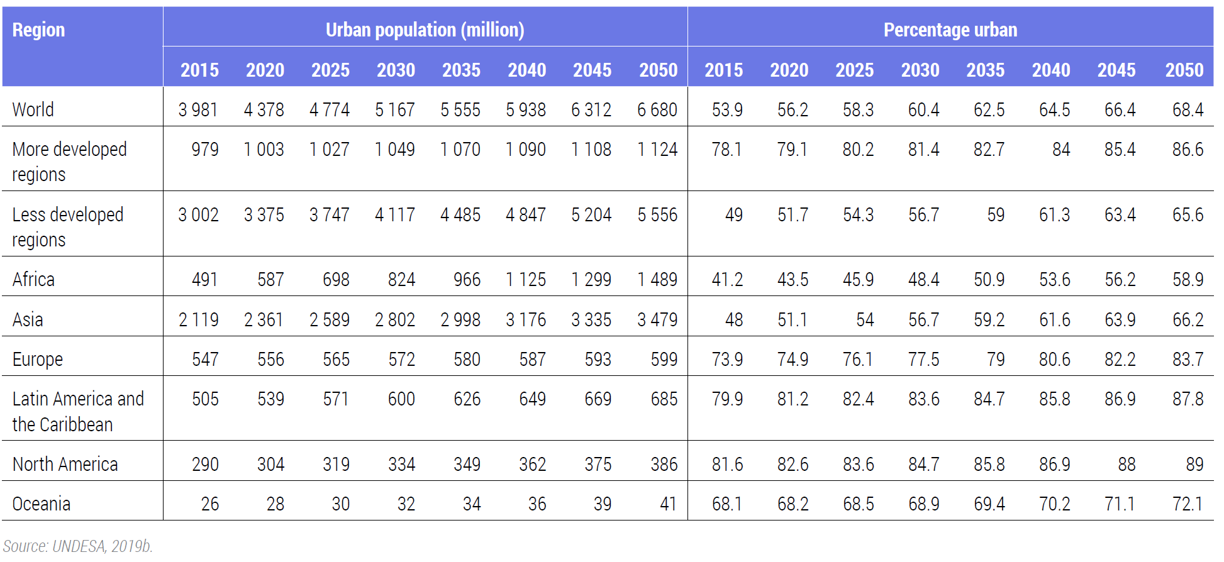
Total global population 8 bn by 15 Nov 2022; 8.5 bn(2030), 9.7 bn (2050); 10.4 bn(2100) - World Population Prospects 2022, UNDESA
World Cities Report 2022, UN-HABITAT
World Cities Report 2022, UN-HABITAT
Future urban growth in less developed regions, especially Africa and Asia
Additional global urban population 2050-2020: 2.3 bn (2.18 bn or almost 95% in less developed regions; 1.1 bn in Asia; 0.9 bn in Africa)
World Cities Report 2022, UN-HABITAT

Slide 11
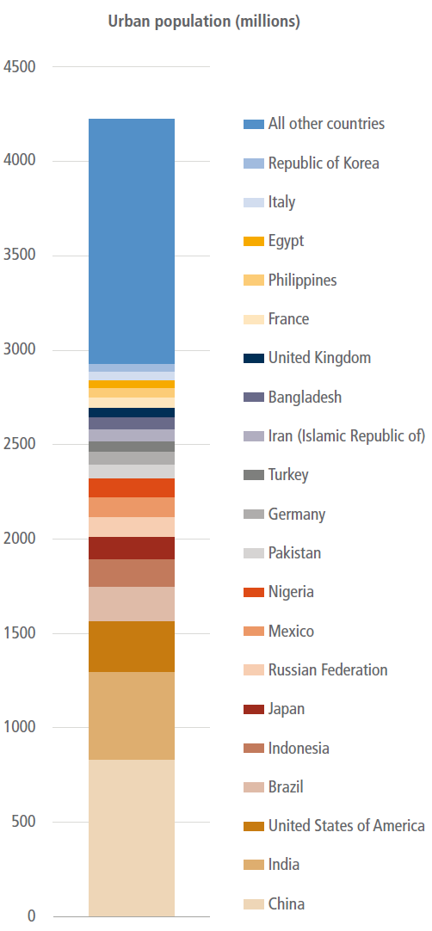
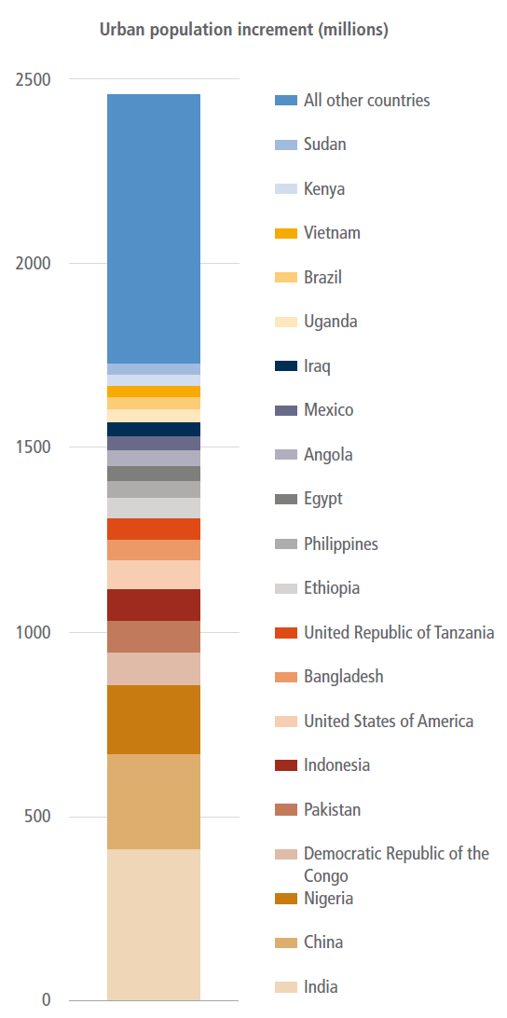
Future of urbanization
Urban land areas could triple between 2015 and 2050 → The construction of new, and upgrading of existing urban infrastructure through 2030 will result/lock in significant emissions
Most future urban population growth will occur in developing countries → where urban emissions per capita emissions are already far higher then rural – double impact
Income and lifestyle effect in developing countries cannot reap benefit of density/compact-city effect that we see in developed world
“Increase” in urban population by 2050 from 2018 to concentrate in eight countries
Lwasa et al. (2022). Urban systems and other settlements. In IPCC, 2022: Climate Change 2022: Mitigation of Climate Change. Contribution of Working Group III to the Sixth Assessment Report of the Intergovernmental Panel on Climate Change . Cambridge University Press, Cambridge, UK and New York, NY, USA. doi: 10.1017/9781009157926.010
4.2 bn urban population in 2018
Notes:
Earlier phases of urbanisation accompanied by rapid industrialisation, development of secondary industries, and high levels of economic growth, are correlated with higher levels of energy consumption and GHG emissions. However, more mature phases of urbanisation, with higher levels of economic development and establishment of the service sector, are correlated with lower levels of energy consumption and GHG emissions

Slide 12
There are options available now in every sector that can at least halve emissions by 2030 (from 2019) → these sectors are:
There are options available now in all sectors that can at least halve emission by 2030 (of 2019)
Demand and services
Energy
Land use
Industry
Urban
Buildings
Transport
Notes:
I will not provide more details in the interest of time but will flip through quantification of such potentials for each sector.

Slide 13
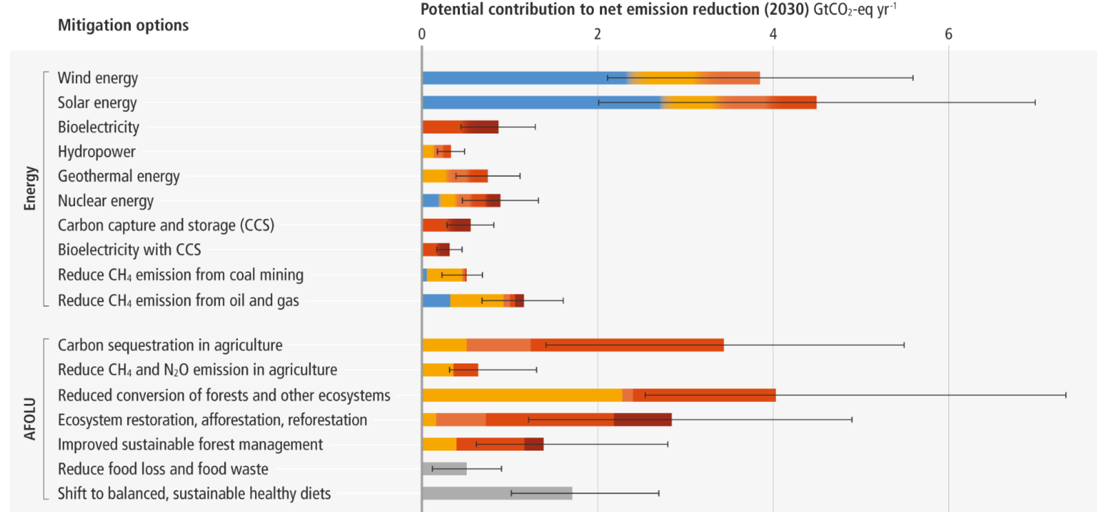
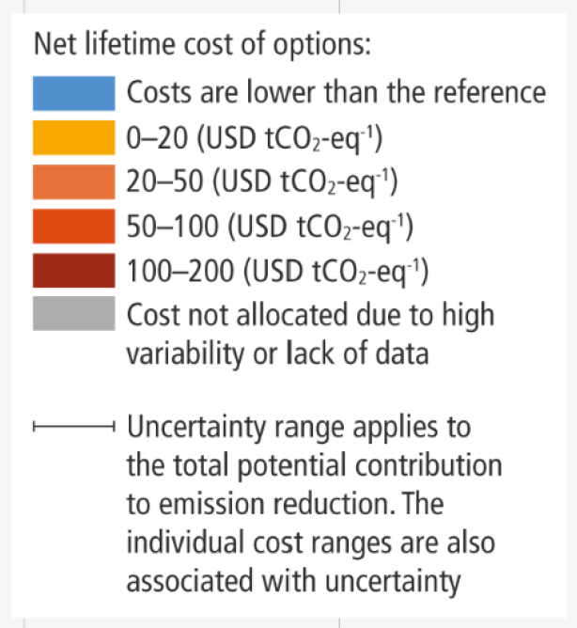
Substantial potentials to reduce net emission by 2030
Notes:
IPCC has provided synthetic knowledge on quantification of such potentials for Energy and AFOLU sector

Slide 14
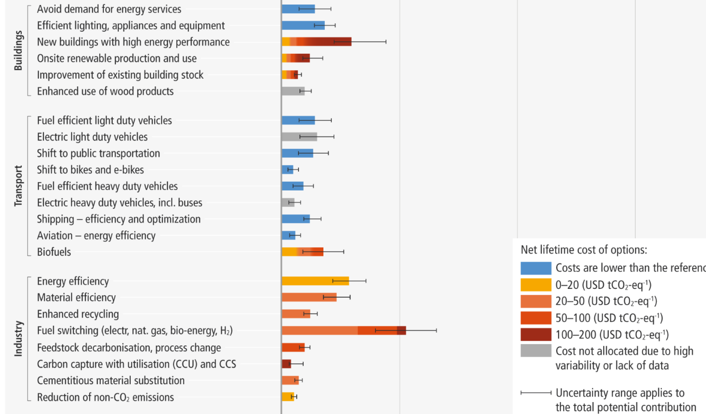
Substantial potentials to reduce net emission by 2030
Notes:
Building, transport, industry and others

Slide 15
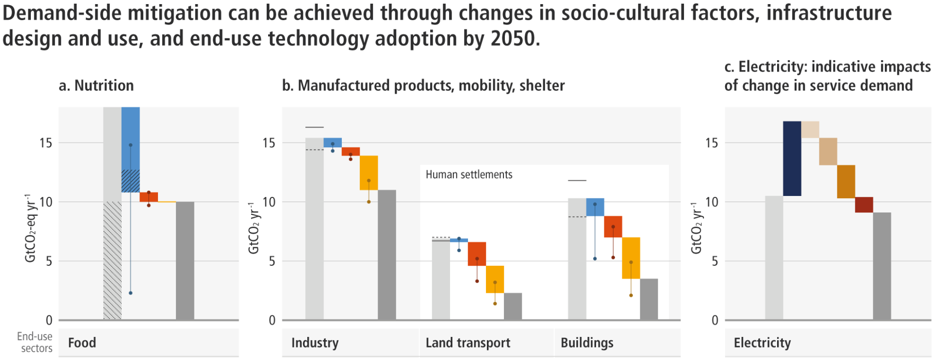
Substantial potentials to reduce net emission by 2030 Indicative potential of demand-side mitigation options by 2050
Notes:
and potentials for options at the demand-side incl lifestyle and choices

Slide 16
Sethi et al (2020) ERL
867 studies synthesized; technological or policy instruments; found 41 different urban solutions with an average GHG abatement potential ranging from 5.2% to 105%, most of them clustering in the building and transport sectors
More than three-fourth of the solutions are on demand side
Results demonstrate that
technology-oriented interventions in urban waste, transport and energy sectors have the highest marginal abatement potential
system-wide interventions, e.g. urban form related measures have lower marginal abatement potential but wider scope
integrating measures across urban sectors realizes synergies in GHG emission reductions
Environ. Res. Lett. 15 (2020) 093008

Slide 17
Urbanization’s wedge in future emissions/ mitigation
WEO (2008) by IEA – urban CO2 emissions 76% by 2030 (energy related)
Brian O’Niels et al.’s limited work, IAM are not addressing urban
Karen Seto et al.’s work from urban land expansion
Daniel Mueller’s work on infrastructure stock (2013)
Felix et al ’s PNAS work on urban typology (2013)
Estimation by SEI-USA for Michael Bloomberg’s initiative (2015)
IEA (2016)
Felix et al. (2016) work on 2040 mitigation potential
Kevin Gurney’s recent work (2022)
Urban mitigation potentials are large – technology in sectors and infrastructure are key
Still lack of scientific studies on future urban mitigation potentials incorporating urban systemic interventions (many are technology centered and sectoral)
Inability of IAM models to handle urban issues
Under SSP 1 scenario (resource efficient and compact cities)- urban GHG reduction of 9.8 GtCO2eq by 2030 and developed countries and Asia is key

Slide 18
Comparison of urban emissions under different urbanisation scenarios
SSP1-RCP1.9-SPA1
SSP2-RCP4.5-SPA2 scenarios
Lwasa et al. (2022). Urban systems and other settlements. In IPCC, 2022: Climate Change 2022: Mitigation of Climate Change. Contribution of Working Group III to the Sixth Assessment Report of the Intergovernmental Panel on Climate Change . Cambridge University Press, Cambridge, UK and New York, NY, USA. doi: 10.1017/9781009157926.010
Gurney et al. (2022)
Notes:
Comparison of urban emissions under different urbanisation scenarios (GtCO2-eq yr–1) for the AR6 WGIII 6-region aggregation. The panels
represent the estimated urban emissions change in two different scenarios for the time period 2020–2030. Panel (a) represents resource efficient and compact urbanisation
while panel (b) represents urbanisation with moderate progress. The two scenarios are consistent with estimated urban emissions under the SSP1-RCP1.9-SPA1 and
SSP2-RCP4.5-SPA2 scenarios, respectively (Figure 8.13). In both panels, urban emissions estimates for the year 2020 are marked by the lines for each region. In the resource
efficient and compact scenario, various reductions in urban emissions that take place by 2030 are represented by the dashed areas within the bars. The remaining solid shaded
areas represent the remaining urban emissions in 2030 for each region on the path towards net-zero emissions. The total reductions in urban emissions worldwide that are given
by the last dashed grey bar in panel (a) is estimated to be 9.8 GtCO2-eq yr–1 between 2020 and 2030 in this scenario. In the scenario with moderate progress, there are no
regions with reductions in urban emissions. Above the white lines that represent urban emissions in 2020, the grey shaded areas are the estimated increases for each region so
that the total urban emissions would increase by 3.4 GtCO2-eq yr–1 from 2020 levels in 2030 under this scenario. The values are based on urban scenario analyses as given in
Gurney et al. (2021, 2022). Source: synthesised based on data from Gurney et al. (2022)

Slide 19
Cities mitigation potentials
IEA (2016)
Under the 2DS, global urban CO2 emissions can be reduced by around 75% in 2050 compared with the 6DS.
Notes:
Many studies have shown that urban areas contributes over 70% of global energy related CO2 emissions. Cities in Asia are crucial part of that.

Slide 20
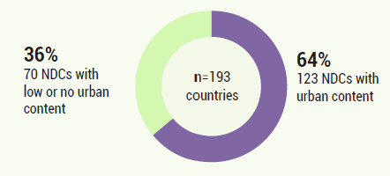
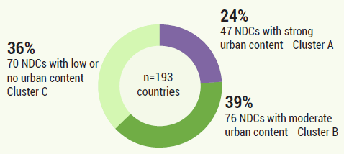
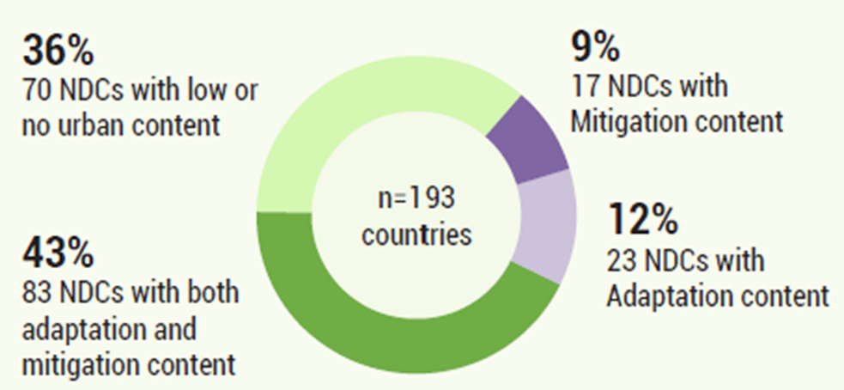
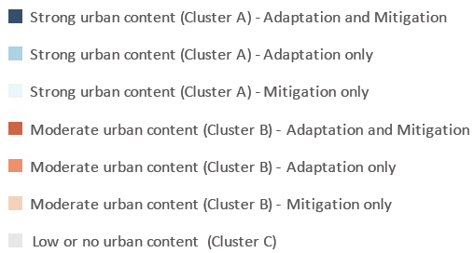
Map of Urban Content in NDCs
72% of global emissions
Urban Climate Action
The urban content of the NDCs: Global review 2022
(UN-Habitat)

Slide 21
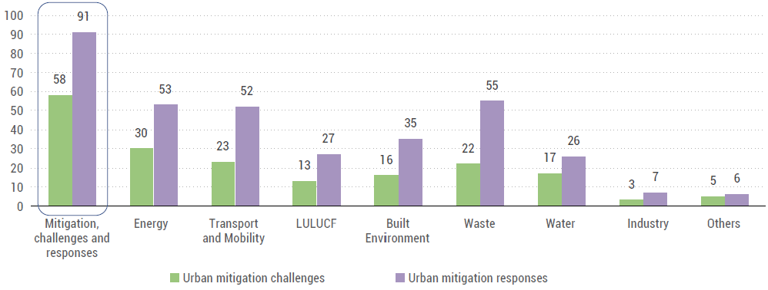
NDCs urban content: Urban mitigation challenges and responses
Urban Climate Action
The urban content of the NDCs: Global review 2022
(UN-Habitat)

Slide 22
Lessons from 278 urban climate action plans (2015-2022)
A transition from mitigation-focused in pre-COP21 to both mitigation and adaptatio
Sectoral focus
Mitigation: About 96% (268) of the sampled urban CAPs are focusing on the transport sector to achieve climate objectives, energy (266), buildings (262), and waste (244) sectors
Adaptation: water resources and management (194), disaster management (159), agriculture-food-pasture systems (156), and health (137)
Mitigation-adaptation: Green-blue infrastructure/nature-based solutions (235), urban governance/policy/planning (226), urban design/land use planning (183), and behavioral issues (165)
Least focused sectors: tourism (representing 8% - 16 of 278 CAPs) and industry (representing 13% - 36 of 278 CAPs)
Equity or climate justice has been fairly represented (37% - 102 of 278 CAPs)
More than half (55%) of cities (147 urban CAPs of 267 urban CAPs) do not have deep decarbonization pledges, with less than a quarter of the pledges likely to be achieved by 2030.
Lack of data driven approach: About 81% of 120 cities with deep decarbonization pledges are more likely to report baseline emission inventory in their urban CAPs
Lack of inclusiveness, transparency and verification, evidence-based climate planning, comprehensiveness, and integration were the most common areas of non-alignment with best practices
The explicit consideration of synergies, trade-offs, or conflicts is significantly low.
Aboagye and Sharifi, 2023 (https://doi.org/10.1016/j.uclim.2023.101550)

Slide 23
Rhetoric vs reality - Scrutinizing the potentials, progress and implantation status of city climate actions (overrated?)
Ambitious target of local governments incl Net-Zero-Emission targets/commitment but less achievements on ground → but they are good start!!
ICLEI, GCoM, UCLG, C40 and other initiatives exist to mobilize local governments – they are necessary but not sufficient !!

Slide 24
Harnessing city scale mitigation potentials
Urban delineation and boundary issues are often obstacle for effective climate actions → largest urban mitigating opportunities does not correspond to one level of governance → governance mismatch
There is yet short supply of comprehensive and comparable GHG inventories of cities → in thousands of cities GHG inventory do not exist – mitigation potentials are unknown, and action are not rooted in evidence-based planning
Multiple frameworks for accounting is must to address all mitigation potentials in cities (next slide)

Slide 25
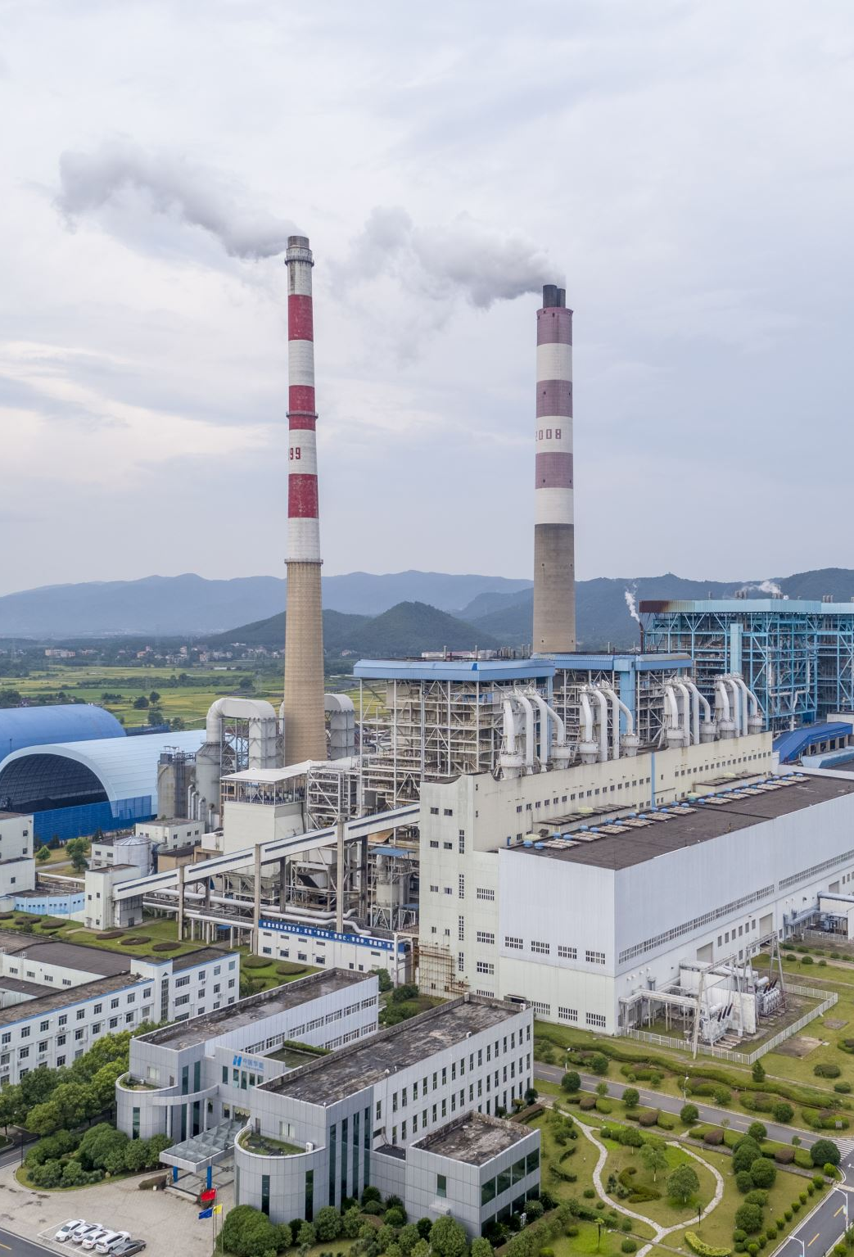
Urban carbon accounting frameworks
Territorial accounting
Community-wide infrastructure supply chain footprinting
Consumption-based carbon footprint accounting with a focus on household on personal consumption
Consumption-based carbon footprint accounting with a focus on final consumption in an area by all consumers
They have each important distinctiveness for policy-relevance

Slide 26
Carbon accounting methods used in 278 cities 27 different approaches
Name of BEI tool or methodology | Africa | Asia | Europe | Latin America | North America | Oceania
Activity-Based GHG Accounting Approach | - | 1 | - | - | - | -
Australia National Carbon Offsetting Standard (NCOS) Accounting Principles | - | - | - | - | - | 1
Australia National Greenhouse and Energy Reporting (NGER) Scheme Guidelines and Factors | - | - | - | - | - | 1
Australia Snapshot Community GHG Climate Tool | - | - | - | - | - | 1
BAAQMD’s GHG Plan Level Quantification Guidance | - | - | - | - | 4 | 1
Bilan Carbone Carbon Assessment Method | - | - | 1 | - | - | -
Community Energy and Emissions Inventory (CEEI) Framework | - | - | - | - | 3 | -
Covenant of Mayors GHG Inventory Criteria | - | 1 | - | - | - | -
European Commission (EC) Joint Research Centre (JRC) Baseline Emission Inventory (BEI) Guidelines | - | - | 1 | - | - | -
European CORINAIR 90 Inventory Process | - | - | 1 | - | - | -
Federation of Canadian Municipalities (FCM) Partners for Climate Protection (PCP) GHG Accounting Protocol | - | - | 1 | - | 2 | -
Global Protocol for Community-Scale GHG Emission Inventories (GPC) | 8 | 6 | 13 | 7 | 54 | 6
ICLEI Clean Air Climate Protection Software (CACP) | - | - | - | - | 2 | -
ICLEI ClearPATH Tool | - | - | - | - | 5 | -
International Local Government GHG Emissions Analysis Protocol (IEAP) | 1 | - | - | - | 3 | -
IPCC GHG Emission Inventory Guidelines | - | 2 | 7 | - | 1 | -
Local Government Operations Protocol (LGOP) for Greenhouse Gas Assessments | - | - | - | - | 12 | 1
Local Partnerships – Local Government Association’s Greenhouse Gas Accounting Tool | - | - | 1 | - | - | -
City-designed BEI tool or methodology | - | 3 | 3 | - | 2 | 1
SCATTER GHG Inventory Tool | - | - | 7 | - | - | -
The Cool Climate Network Carbon Calculator for Households – inventory of household emissions | - | - | - | - | - | 1
U.S. Community Protocol for Accounting and Reporting of Greenhouse Gas Emissions (Community Protocol) | - | - | - | - | 29 | -
US Environmental Protection Agency Carbon Footprint Reporting Methodology from Greenhouse Gas Reporting Program (GHGRP) | - | - | 1 | - | 1 | -
US Environmental Protection Agency Portfolio Manager | - | - | - | - | - | -
City Inventory Reporting and Information System (CIRIS) Tool | 2 | - | - | - | - | -
Demand-Centred Hybrid Life Cycle Analysis Methodology for conducting city-scale GHG Inventories | - | - | - | - | 1 | -
Climate Action for Urban Sustainability (CURB) Tool GHG Modeling Approach | - | - | - | - | 1 | -
Aboagye and Sharifi, 2023 (https://doi.org/10.1016/j.uclim.2023.101550)

Slide 27
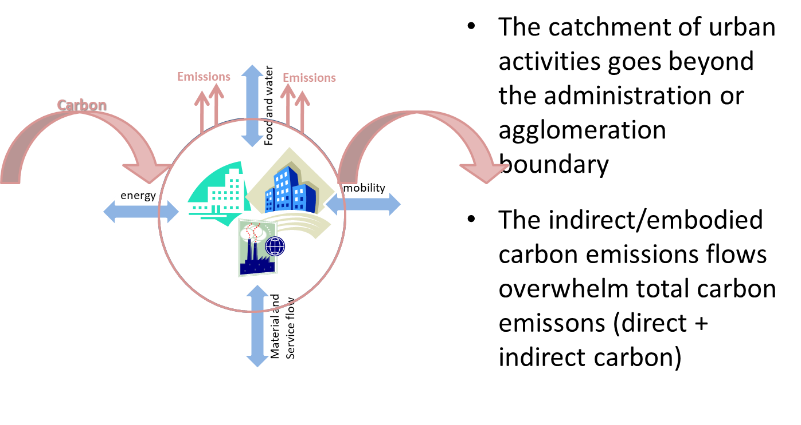
The boundary issues
Beyond traditional thinking
The urban as open system - the question of cross boundary energy and other infrastructure
The question of indirect implications

Slide 28
Key opportunities for transformative change
Avoiding emissions ‘lock-in’ in rapidly urbanizing region
Infrastructure and spatial planning, technology, institutional, policy, behavior are key to unlock
Large opportunities in cities-being-rapidly-built for spatial and infrastructure planning !! But but effort needed to re-orient
Re-engineering already-built cities
Energy efficiency, clean energy production and procurement, smart grids
Urban green and urban carbon sequestration with co-benefits
Demand side behavioral change (avoid, shift, improve)
Disruptive innovations, technologies and behavior
Digitalization as drivers for change
Bridging mitigation potential’s policy and governance paradox

Slide 29
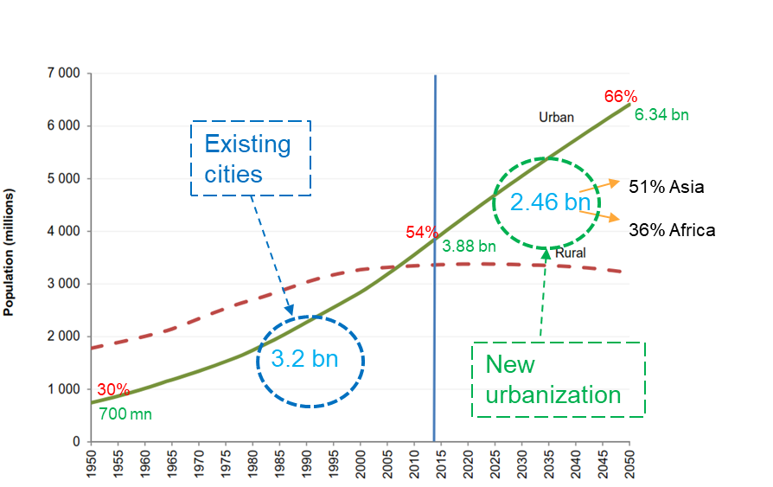
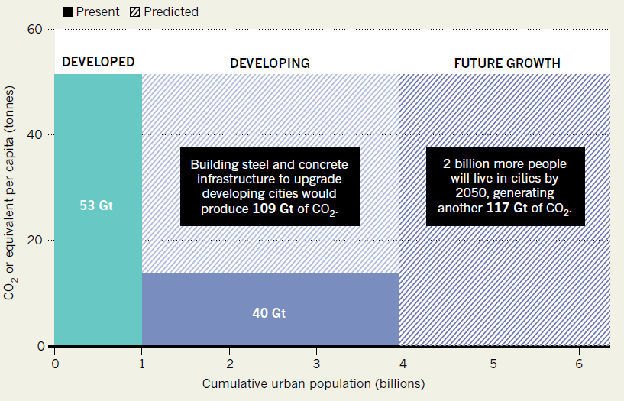
Key opportunities for transformative change
Avoiding ‘lock-in’ in rapidly urbanizing regions
Urban design and spatial planning
Infrastructure
Population density, mixed land-use, accessibility, and connectivity
Large window of opportunity for next two decades
Source: Bai et al. (2018), Nature, 28 Feb 2018, base on Müeller, D. B. et al. Environ. Sci. Technol. 47, 11739–11746 (2013).

Slide 30
Key opportunities for transformative change
Re-engineering the existing built cities
Accelerated ‘green’ infrastructure replacement
System efficiency, best practices, and new technologies
Benefitting from Cost reduction in key RE technologies → greater RE in electricity → Reducing battery storage cost → Distributed energy and prosumer → EVs with more RE is into the grids
Re-orienting public choices and consumption through sound incentives, policies and governance
Oslo’s pro-active attitude
Tokyo’s efficiency
Developing an effective Climate Action Plans in cities is urgent
Now, too focused on energy efficiency and end-of-pipe solutions only; aggregate impact of actions on urban emissions unclear

Slide 31
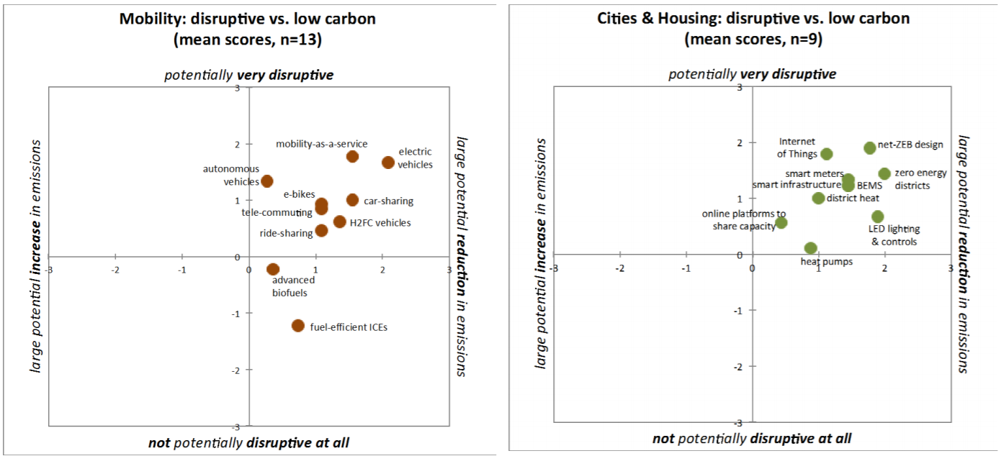
Key opportunities for transformative change
Disruptive innovations, technologies, and behaviour
Wilson, C. (2017). Disruptive Low Carbon Innovation Workshops: Synthesis Report. Tyndall Centre for Climate Change & Future Earth. Norwich, UK. April 2017. Tyndall Working Paper 164.

Slide 32
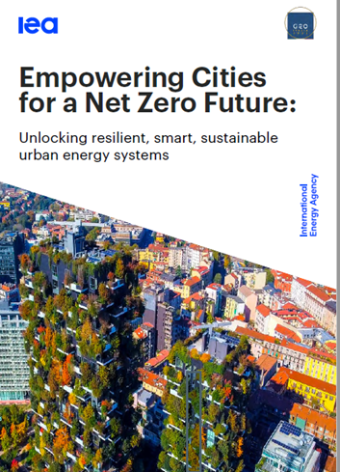
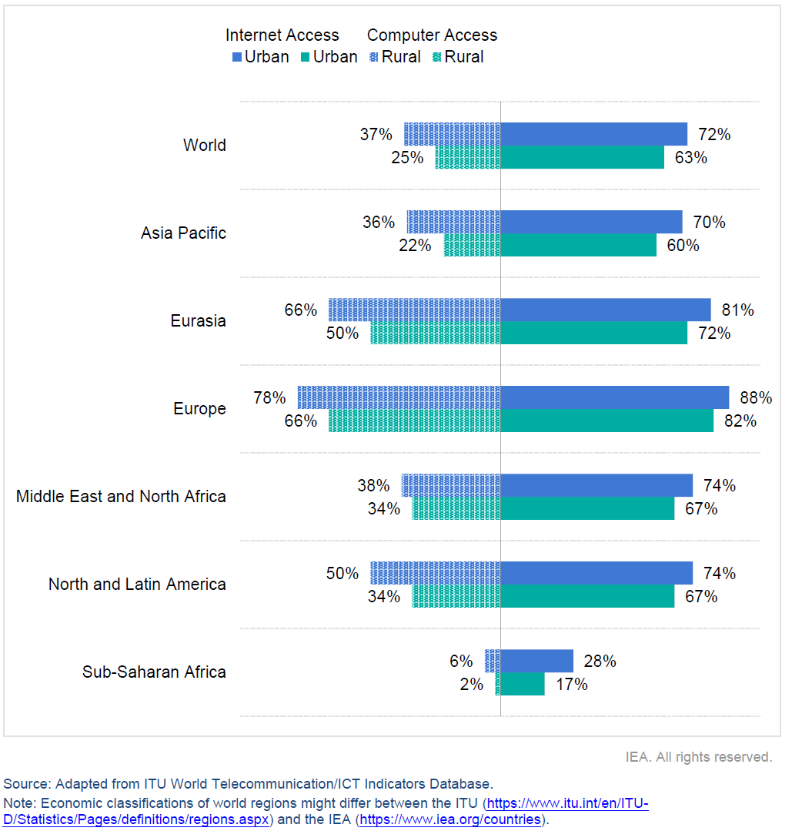
Key opportunities for transformative change
Digitalization as drivers for change
Digitalization is driving sustainable energy transitions in cities
Digitalization and smart controls can reduce emissions from buildings by 350 Mt CO2 by 2050
IEA (2021). Empowering Cities for a Net Zero Future: Unlocking resilient, smart, sustainable urban energy systems, IEA, July 2021

Slide 33
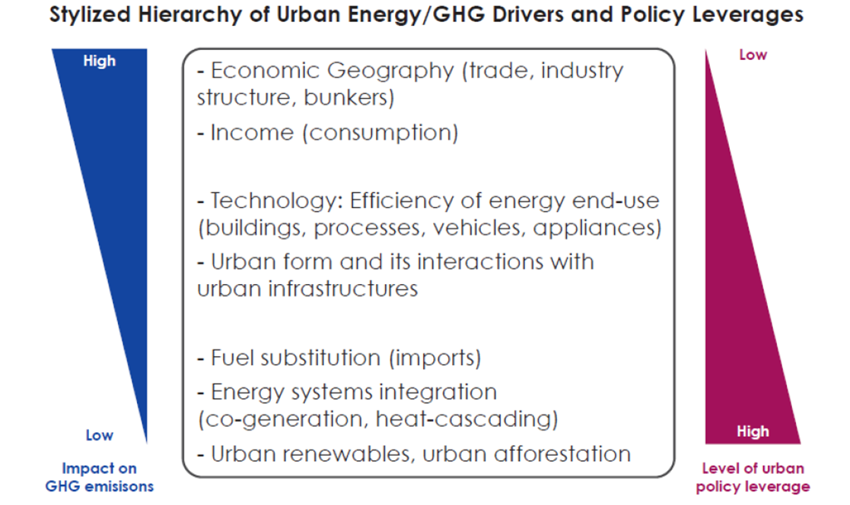
Bridging mitigation potential’s policy and governance paradox
Key opportunities for transformative change
Largest mitigation come from systemic change
But systemic change requires overcoming policy fragmentation and dispersed, uncoordinated decision making
Source: Global Energy Assessment, KM 18
Seto, Dhakal et al. (2014), IPCC AR5

Slide 34
Where do we go from here !!
Evidence-based planning → role of research and knowledge
Incremental change→ transformative change and systemic approach as opposed to sectoral
Deploying far-reaching solutions coupled with planning, such as spatial planning and pricing tools
Overcoming the governance paradox and policy fragmentations
Smoothening entry points for best practice technologies and scaling-up as urban-scale actions
No silver bullets !!! All solutions are context specific

Slide 35
Thank you
Shobhakar.Dhakal@gmail.com
Shobhakar@ait.ac.th

Slide 36
There are options available now in all sectors that can at least halve emission by 2030 (of 2019)
Options to reduce GHG emissions by at least half of the 2019 level by 2030 are available at a cost of USD100 tCO2-eq or less
Options costing less than USD20 tCO2-eq make up more than half of the 2030 reduction potential
The monetary benefits of a small number of options exceed their costs (Solar and wind energy, energy efficiency improvements, natural habitat conservation and methane emissions reductions)
Limiting warming to 2°C would cost only few percentage point (4.5% or less) of GDP while projected GDP would increase by about 100% over 2020-50 (this does not include economic benefits of reduced adaptation costs or avoided climate impacts)
Notes:
IPCC had shown that there are options available now in all sectors that can at least halve emission by 2030 (of 2019).

Slide 37
Mitigation options in urban areas
Notes:
Talking about SDGs,…….. Lets say…..green and blue infrastructure as a mitigation option ….. we see that green roofs and facades, networks of parks and open spaces, wetlands and urban agriculture not only absorb and store carbon but, at the same time, achieve many other sustainable development goals as you can see with the squares in this graph.
For example, they can reduce pressure on urban sewer systems, reduce flood risk and heat-island effects. They can also deliver health benefits from reduced air pollution.

Slide 38
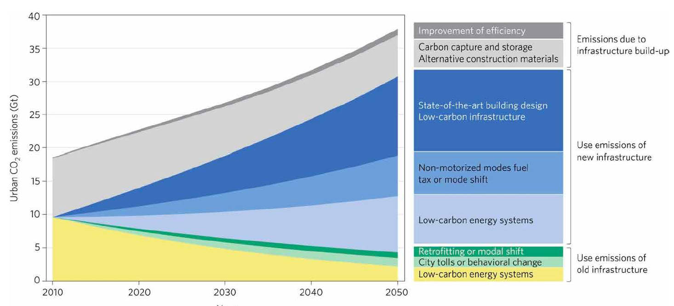
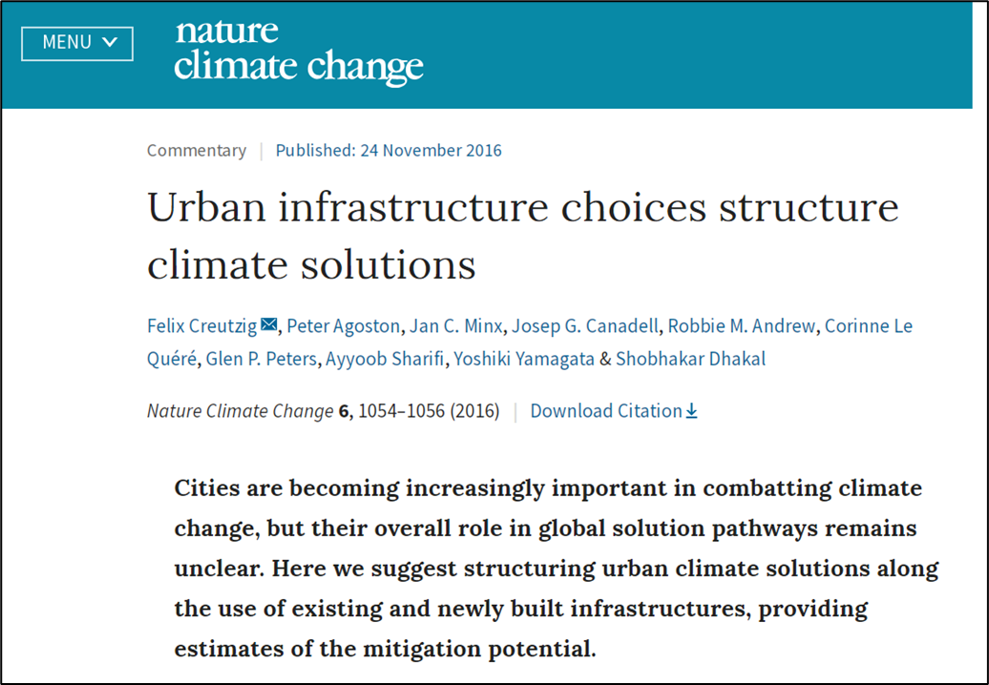
Lack of scientific studies on future scenario of urban emissions and mitigation potentials
Urban infrastructure-based CO2-eq emission mitigation wedges
Creutzig et al. (2016)
Reference scenario and mitigation potential for global urban areas in the residential and commercial building, transport, waste, and material production sectors

Slide 39
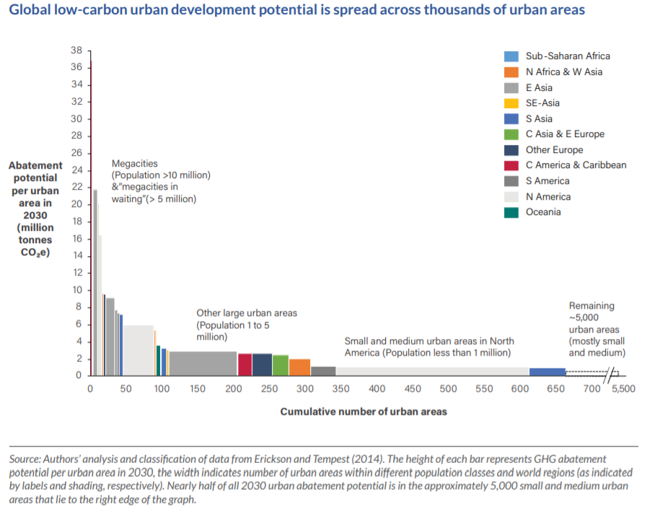
Broekhoff, D., Piggot, G., Erickson, P. 2018. Building Thriving, Low-Carbon Cities: An Overview of Policy Options for National Governments. Coalition for Urban Transitions. London and Washington, DC. Available at: http://newclimateeconomy.net/content/cities-working-papers

Slide 40
IEA (2021). Empowering Cities for a Net Zero Future: Unlocking resilient, smart, sustainable urban energy systems, IEA, July 2021

